Slide 1
TEXT-TO-SPEECH
Classical TTS: Text Frontend, Acoustic Models & Vocoders
From text normalization to perceptual evaluation
COMP 4147/ COMP 7135 Audio & Speech Processing
Hong Kong Baptist University
01 / 61
Notes:
[Sources]
- User-provided outline: week9 TTS 大纲.docx
- User-provided reference deck and diagrams: week 9 _ Classical TTS.pptx
- Visual style follows the user-provided source-separation courseware.

Slide 2
Course Overview
Part A · The TTS pipeline
Part B · The vocoder & evaluation
• Text normalization & G2P
• Acoustic models (Tacotron 2 & FastSpeech)
• Prosody, style & speaker conditioning
• Alignment mechanisms & Duration modeling
• Intermediate representations
(Mel-spectrograms)
• Neural vocoders (WaveNet → Parallel WaveGAN → MelGAN → HiFi-GAN)
• Waveform synthesis from spectral features
• Subjective evaluation
(MOS, MUSHRA, preference tests)
• Objective metrics (Confidence intervals)
02 / 61
Notes:
[Sources]
- User-provided outline: week9 TTS 大纲.docx
- User-provided reference deck and diagrams: week 9 _ Classical TTS.pptx

Slide 3
COURSE MAP
Learning objectives
Trace the full TTS pipeline from text normalization down to waveform generation.
Distinguish training vs. inference modes and implicit vs. explicit alignment mechanisms.
Connect acoustic model & neural-vocoder architectures to their repective loss functions.
Select speech quality evaluation methods (MOS/MUSHRA) and interpret statistical confidence intervals.
Prerequisites: STFT, convolution, attention and basic statistics
03 / 61
Notes:
The aim is to explain the system and inspect how its mechanisms appear in code. We will trace representations from text to samples, distinguish training and inference, and compare learned alignment with supervised duration expansion. We will also connect vocoder components to losses and interpret quality tests with appropriate uncertainty. Familiarity with the STFT, convolution, attention and basic statistics provides the starting point.

Slide 4
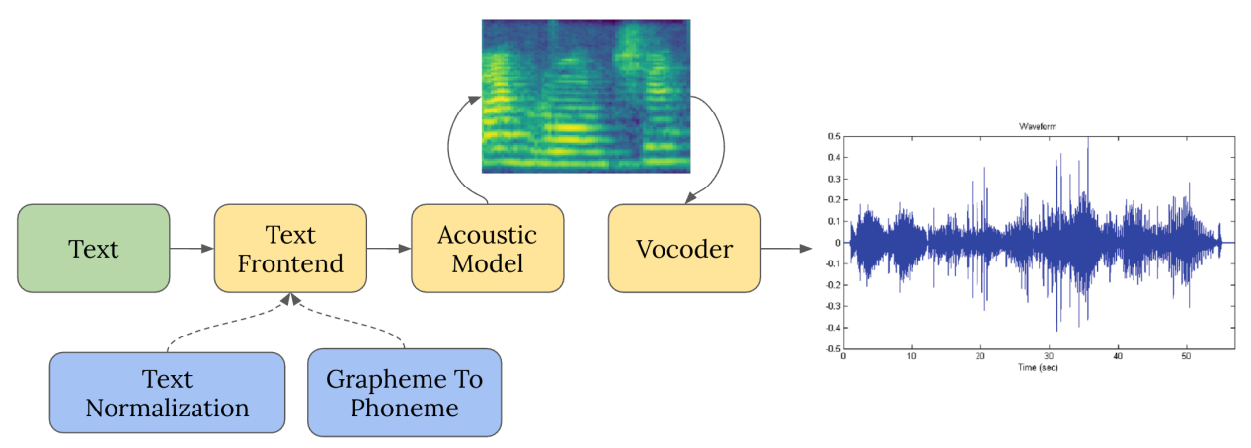
What is TTS?
Three Modules
Why stage the problem?
• Text frontend turns ambiguous writing into a pronounceable sequence.
• Acoustic model predicts a smooth, time-frequency target.
• Vocoder restores phase, fine structure, and audible detail.
• Different modules operate at different time scales.
• Intermediate targets are easier to supervise than raw waveform samples.
• Each module can be replaced, profiled, and debugged independently.
04 / 61
Notes:
[Sources]
- User-provided outline: week9 TTS 大纲.docx
- User-provided reference deck and diagrams: week 9 _ Classical TTS.pptx

Slide 5
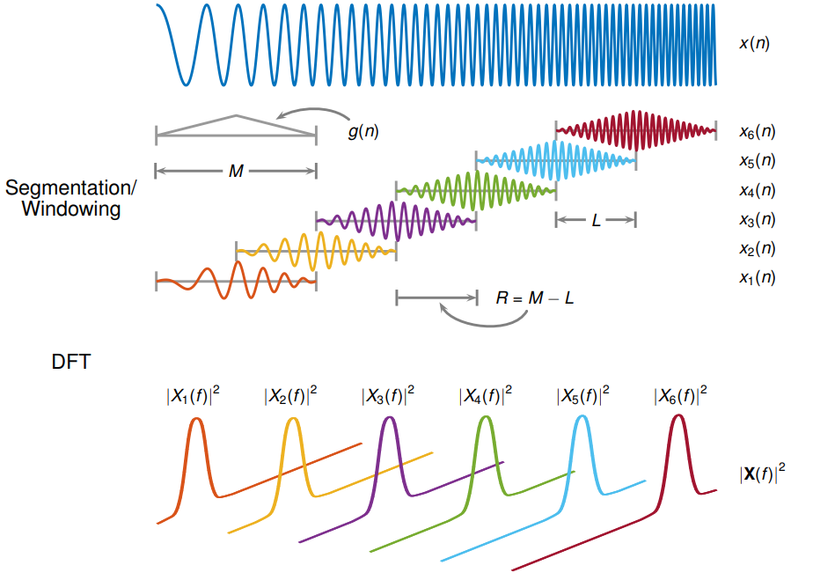
REPRESENTATIONS
Mel-spectrograms trade exactness for trainability
Pipeline
Step 1: Framing & windowing
Segment raw waveform x(n) into overlapping frames using a window function g(n) (e.g., Hann window).
Step 2: Apply DFT (STFT)
Apply DFT to each frame to compute the magnitude / power spectrum |X(f)|².
Step 3: Mel Filterbank Pooling
Pass magnitude spectra through non-linear triangular filterbanks to extract energy in Mel scale.
Step 4: Log compression & stacking
Apply dynamic-range compression and stack frame vectors into a 2D mel-spectrogram matrix.
06 / 61
Notes:
[Sources]
- User-provided outline: week9 TTS 大纲.docx
- User-provided reference deck and diagrams: week 9 _ Classical TTS.pptx

Slide 6
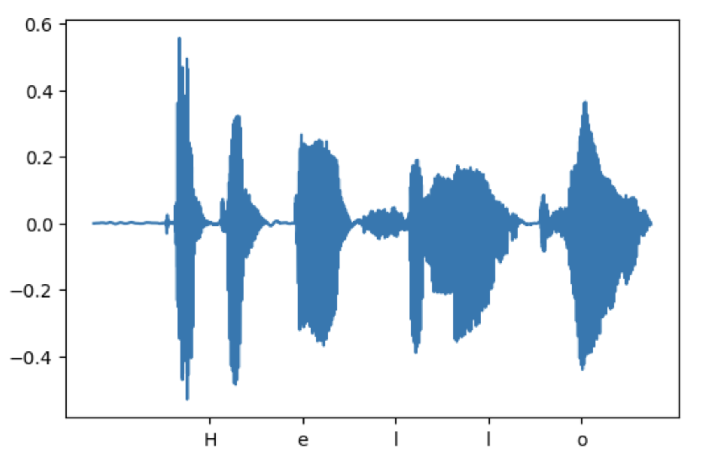
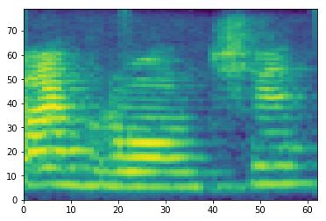
Why Mel-spectrogram as an Intermediate Target?
Waveform (Raw Time-Domain Audio)
• High temporal resolution: 24k-48k samples per seconds (24 kHz+)
• Phase sensitiviity: Minor phase/timing shifts produce huge point-wise errors, yet sound virtually identical to human ears.
• Loss mismatch: Point-wise losses (e.g., L1/L2) severely penalize perceptually equivalent waveforms.
Mel-spectrogram
• Lower frame rate: Reduced temporal dimension (~80–100 frames/sec), making sequence modeling manageable.
• Perceptual alignment: Mel scale mimics the non-linear frequency resolution of human auditory perception.
• Effective objective: MSE in log-mel space provides a stable and perceptually meaningful regression target.
05 / 61
Notes:
[Sources]
- User-provided outline: week9 TTS 大纲.docx
- User-provided reference deck and diagrams: week 9 _ Classical TTS.pptx

Slide 7
TEXT FRONTEND
Text frontend: Text Normalization + G2P
Raw text
Text normalization
G2P
Phonemes + metadata
1. Text normalization
2. Grapheme-to-Phoneme (G2P)
Converting non-standard text into canonical spoken words.
Mapping written letters (grapheme) to acoustic sound units (phonemes).
e.g.
e.g.
“10 kg”
“ten kilograms”
“read”
“/r iː d/” or “/r ɛ d/”
“$12”
“twelve dollars”
“21/09”
“twenty-first of September”
(Context-depentent)
07 / 61
Notes:
[Sources]
- User-provided outline: week9 TTS 大纲.docx
- User-provided reference deck and diagrams: week 9 _ Classical TTS.pptx

Slide 8
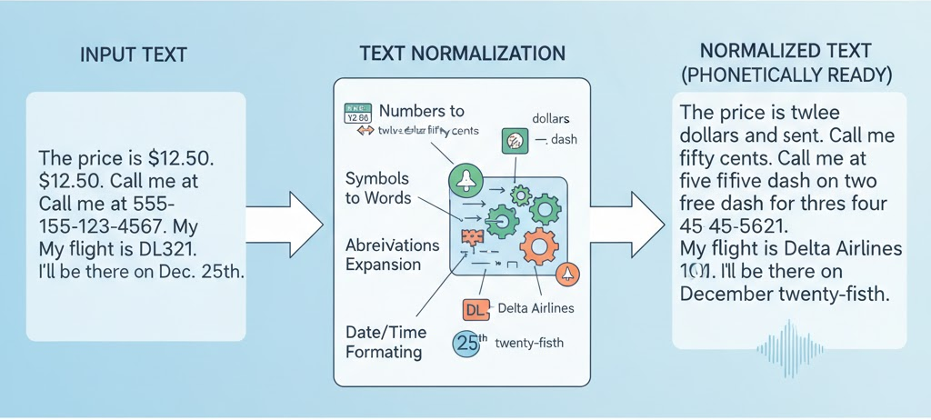
TEXT FRONTEND
Text frontend: Text normalization
08 / 61
Notes:
Rules and finite-state transducers encode explicit language patterns and provide control, but expanding coverage requires maintenance. Sequence-to-sequence models learn written-to-spoken mappings from examples and can still make semantic errors. Hybrid systems constrain sensitive cases with rules while using learned models for broader coverage. Numbers, dates, currency, abbreviations and locale each deserve separate tests.

Slide 9
TEXT FRONTEND
Text frontend: Text normalization Strategies
1. Rules-base & finite-state transducers(FST)
Relying on linguistics rules written by humans.
For instance, it knows that the number following the "$" is usually pronounced as "dollars".
2. Seq2Seq (Neural Networks)
Based on learning the transformation rules of the text from the model
Input is an unstandardized text sequence, while output is the standardized text sequence.
3. Hybrid systems
Use Rule-based approach to handle common situations, and leave the unmatched parts to seq2seq.
09 / 61
Notes:
Rules and finite-state transducers encode explicit language patterns and provide control, but expanding coverage requires maintenance. Sequence-to-sequence models learn written-to-spoken mappings from examples and can still make semantic errors. Hybrid systems constrain sensitive cases with rules while using learned models for broader coverage. Numbers, dates, currency, abbreviations and locale each deserve separate tests.

Slide 10
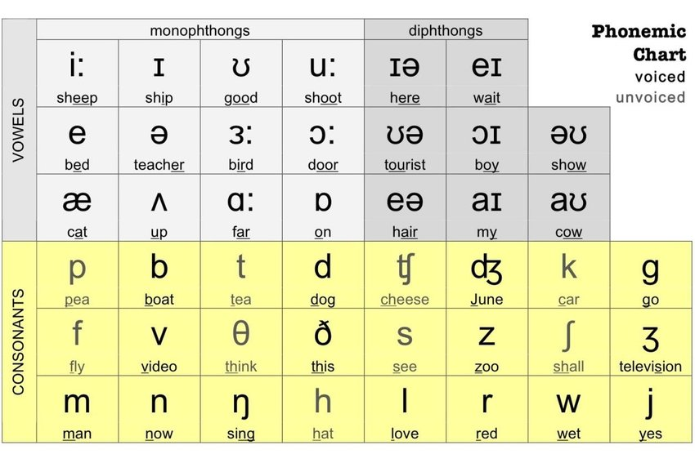
TEXT FRONTEND
Text frontend: G2P Strategies
1. Lexicon Lookup
Look up the word in the dictionary.
For intstance, CMU Pronouncing Dictionary.
2. Rules-base & finite-state transducers(FST)
Utilizing the pronunciation rules summarized by linguists
For instance, In English, words ending with "tion" usually have the pronunciation /ʃən/.
3. Seq2Seq
Use Rule-based approach to handle common situations, and leave the unmatched parts to seq2seq.
The input is a sequence of letters, and the output is a sequence of phonetic symbols.
10 / 61
Notes:
Rules and finite-state transducers encode explicit language patterns and provide control, but expanding coverage requires maintenance. Sequence-to-sequence models learn written-to-spoken mappings from examples and can still make semantic errors. Hybrid systems constrain sensitive cases with rules while using learned models for broader coverage. Numbers, dates, currency, abbreviations and locale each deserve separate tests.

Slide 11
TEXT FRONTEND
Review: Frontend Decisions
Meaning or pronunciation?
1. Why can 21.09 have more than one reading?
2. Which module resolves an unseen name's pronunciation?
3. Why cannot a high-quality vocoder fix an incorrectly expanded number?
11 / 61
Notes:
These questions separate meaning errors from pronunciation errors. Consider why the same written token can be a number or date, which module handles an unfamiliar name, and whether waveform reconstruction can repair an earlier semantic mistake. Trace the first incorrect representation rather than judging only the final sound.

Slide 12
TEXT FRONTEND
Reference answers: Frontend Decisions
Correct synthesis starts with correct interpretation
1. Locale, domain and sentence context distinguish a date from a number.
Date: "twenty-first of September" or "September twenty-first"
Number: "twenty-one point zero nine"
2. G2P (Grapheme-to-Phoneme).
It uses a custom lexicon override for hardcoded entries or a neural/learned G2P model as a fallback for OOV (out-of-vocabulary) words.
3. The vocoder follows acoustic conditioning.
It cannot recover the intended written meaning from incorrectly predicted features.
12 / 61
Notes:
Locale, domain and sentence context distinguish a date from a number. G2P resolves an unfamiliar name's pronunciation using a lexicon override or a learned fallback. A vocoder follows its acoustic conditioning and cannot recover the intended written meaning from incorrect features. Correct synthesis therefore begins with correct symbolic interpretation.

Slide 13
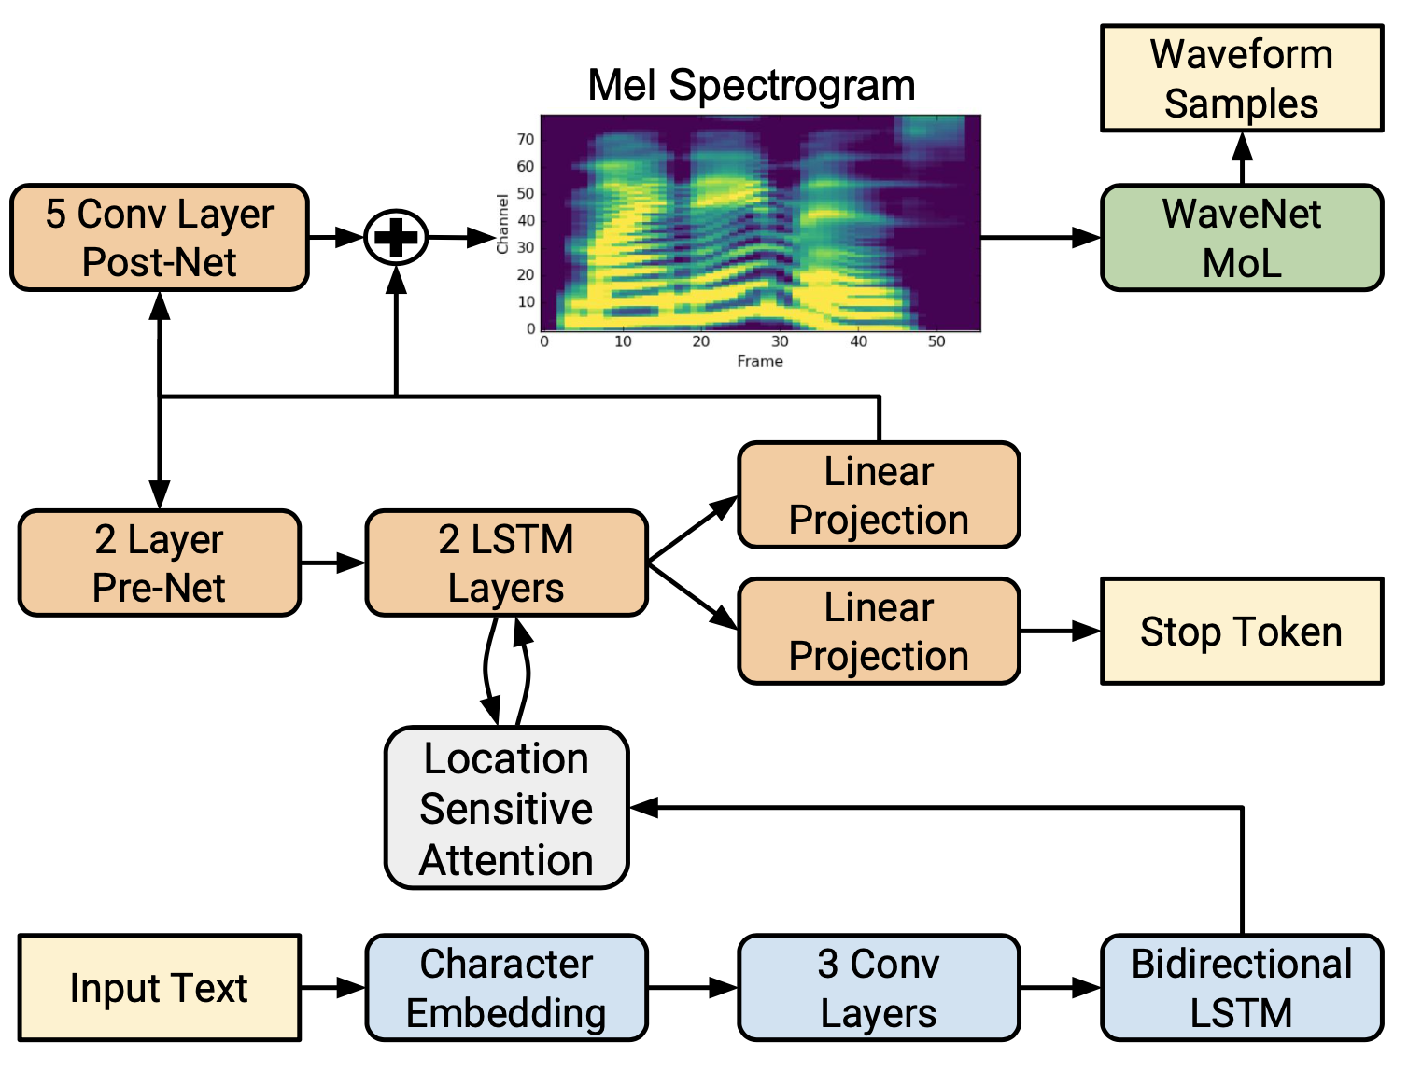
ACOUSTIC MODEL
Acoustic Model: Tacotron 2
1. Text Encoder
Encoder character/phoneme sequence into rich contextual representation via 3 Conv layer + LSTM.
2. Location-sensitive attention
Aligns text positions with decoder steps, using cumulative attention weights to prevent repeating or skipping words.
3. MelSpectrogram Decoder
Autoregressively predicts Mel-spectrogram frames sequentially using a 2-layer LSTM network.
4. Pre-Net & Post-Net
Pre-Net: Acts as an information bottleneck to prevent auto-regressive memory overfitting.
Post-Net: 5-layer CNN that predicts residual features to refine smooth spectograms.
5. Loss Functions (MSE & CE)
MSE: Applied before and after Post-Net for Mel-spectrogram reconstruction loss.
CE: Predicts the probability of the Stop Token for dynamic sequence termination.
13 / 61
Notes:
[Sources]
- User-provided outline: week9 TTS 大纲.docx
- User-provided reference deck and diagrams: week 9 _ Classical TTS.pptx
- Tacotron 2, arXiv:1712.05884

Slide 14
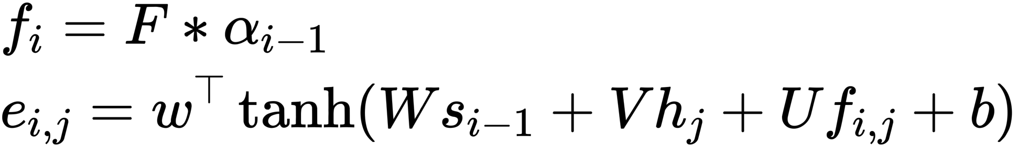
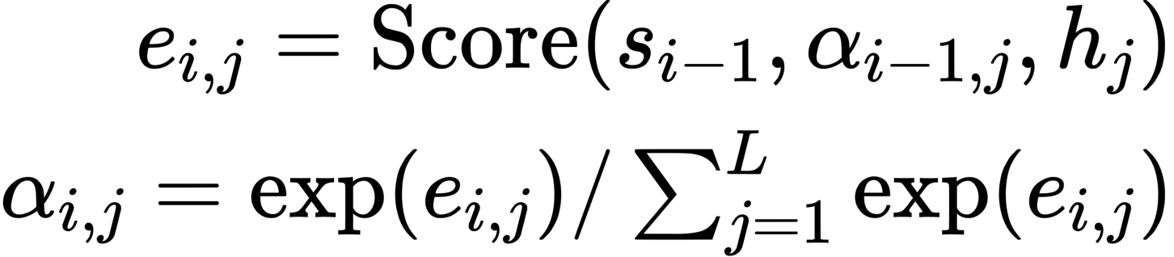
ACOUSTIC MODEL
Tacotron 2: Location-sensitive attention (LSA)
Mathematical Formulation
Mechanism & Failure Modes
Dual-Driven Attention Mechanism
• Content Match: which phoneme matches this frame?
• Location Aware: which positions have already received attention?
• Synergy: Enforces monotonic progression and prevents random attention jumping.
Failure signature
• Word Repetitions: Model gets stuck in a loop at position j.
• Word Skips: Attention jumps forward prematurely.
• Endless Generation: Model fails to trigger the Stop Token.
• s_{i-1}: Previous decoder state (Acoustic context)
• h_{j}: Encoder output at position j (Text content)
• f_{i,j}: Accumulated location feature from 1D conv F
14 / 61
Notes:
[Sources]
- User-provided outline: week9 TTS 大纲.docx
- User-provided reference deck and diagrams: week 9 _ Classical TTS.pptx
- Tacotron 2, arXiv:1712.05884

Slide 15
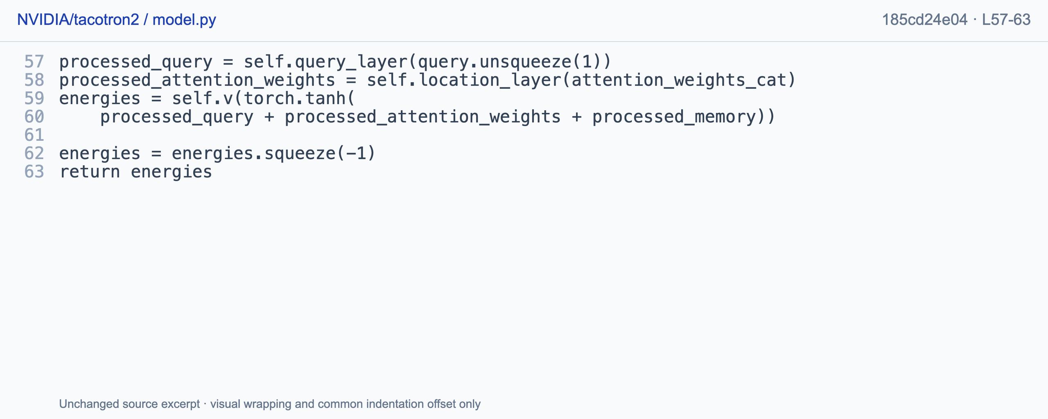
ACOUSTIC MODEL
Tacotron 2: LSA Code Implementation
One score per
text position
Decoder query,
location features and
encoder memory
combine before scoring.
Energies: [B, N]
Softmax follows in
the calling path.
Location sensitivity supplies position information, not a hard monotonic constraint.
NVIDIA Corporation · NVIDIA/tacotron2 · BSD-3-Clause · model.py L57-63 · commit 185cd24e04
15 / 61
Notes:
The source equations connect attention scoring to normalized weights and location features. The attention scorer combines a projected decoder query, location features from previous and cumulative attention weights, and projected encoder memory. A nonlinear projection produces energies with shape batch by text length. Softmax occurs later, so the excerpt supplies neither probabilities nor a hard monotonic constraint by itself. The original equation illustrations come from TTS_second slide fifteen. The exact NVIDIA source is https://github.com/NVIDIA/tacotron2/blob/185cd24e046cc1304b4f8e564734d2498c6e2e6f/model.py#L57-L63.

Slide 16
ACOUSTIC MODEL
Tacotron 2: Pre-Net & Post-Net
Pre-Net (Information Bottleneck)
Structure: 2 FC layers (256 units) with ReLU & Dropout (p=0.5).
Input: Previous Mel-spectrogram frame.
Core Role:
Acts as an information bottleneck to prevent the autoregressive decoder from merely memorizing the previous frame.
Reduces over-reliance on historical speech frames, forcing attention to rely on text representations.
Post-Net (Spectrogram Refinement)
Structure: 5 1D Conv layers (Batch Normalization + Tanh).
Input: Coarse Mel-spectrogram from linear projection.
Core Role:
Predicts a residual signal to add to the coarse Mel prediction: Mel _{final} = Mel _{coarse} + Post-Net(Mel_{coarse})
Sharpens local time-frequency details and smooths synthesis artifacts.
Supervision: Both coarse and refined Mels are optimized using MSE Loss.
16 / 61
Notes:
[Sources]
- User-provided outline: week9 TTS 大纲.docx
- User-provided reference deck and diagrams: week 9 _ Classical TTS.pptx
- Tacotron 2, arXiv:1712.05884

Slide 17
ACOUSTIC MODEL
Tacotron 2 : Acoustic Fidelity & Termination
Mel reconstruction(Acoustic Fidelity)
Stop prediction(Sequence Termination)
L_{mel} = || M_{pred} − M_{target} ||²
L_{stop} = CE(stop_{pred}, stop_{target})
• Frame-level regression
Directly minimizes the distance between predicted and ground-truth Mel-spectrograms.
• Why Mel-Spectrogram?
Smoother, lower-dimensional intermediate representation compared to raw time-domain waveforms.
• Binary Classification Task
Predicts the probability [0 , 1]that the current frame is the end of the sequence.
• Inference Threshold Control
Stops generation when p(stop) > threshold(typically 0.5).
• Calibration Risks
Threshold too low: Premature speech truncation (words cut off at the end).
Threshold too high: Trailing silence or infinite generation loops with static noise.
The loss does not guarantee natural speech: it only defines what the model is asked to match.
17 / 61
Notes:
[Sources]
- User-provided outline: week9 TTS 大纲.docx
- User-provided reference deck and diagrams: week 9 _ Classical TTS.pptx
- Tacotron 2, arXiv:1712.05884

Slide 18
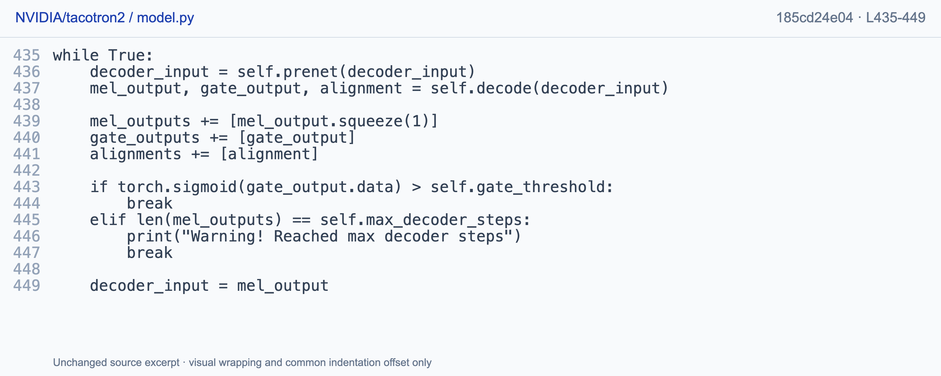
ACOUSTIC MODEL
Code: stopping at inference
Prediction feeds back; sigmoid gate or max steps ends the loop. This excerpt assumes one utterance.
NVIDIA Corporation · NVIDIA/tacotron2 · BSD-3-Clause · model.py L435-449 · commit 185cd24e04
18 / 61
Notes:
Inference transforms the current input, predicts mel and gate outputs, and collects the alignment. The sigmoid gate threshold or maximum decoder steps terminates the loop, otherwise the predicted mel becomes the next input. The displayed condition assumes single-utterance inference and should not be copied unmodified as a general batched stop rule. The pinned NVIDIA code is https://github.com/NVIDIA/tacotron2/blob/185cd24e046cc1304b4f8e564734d2498c6e2e6f/model.py#L435-L449.

Slide 19
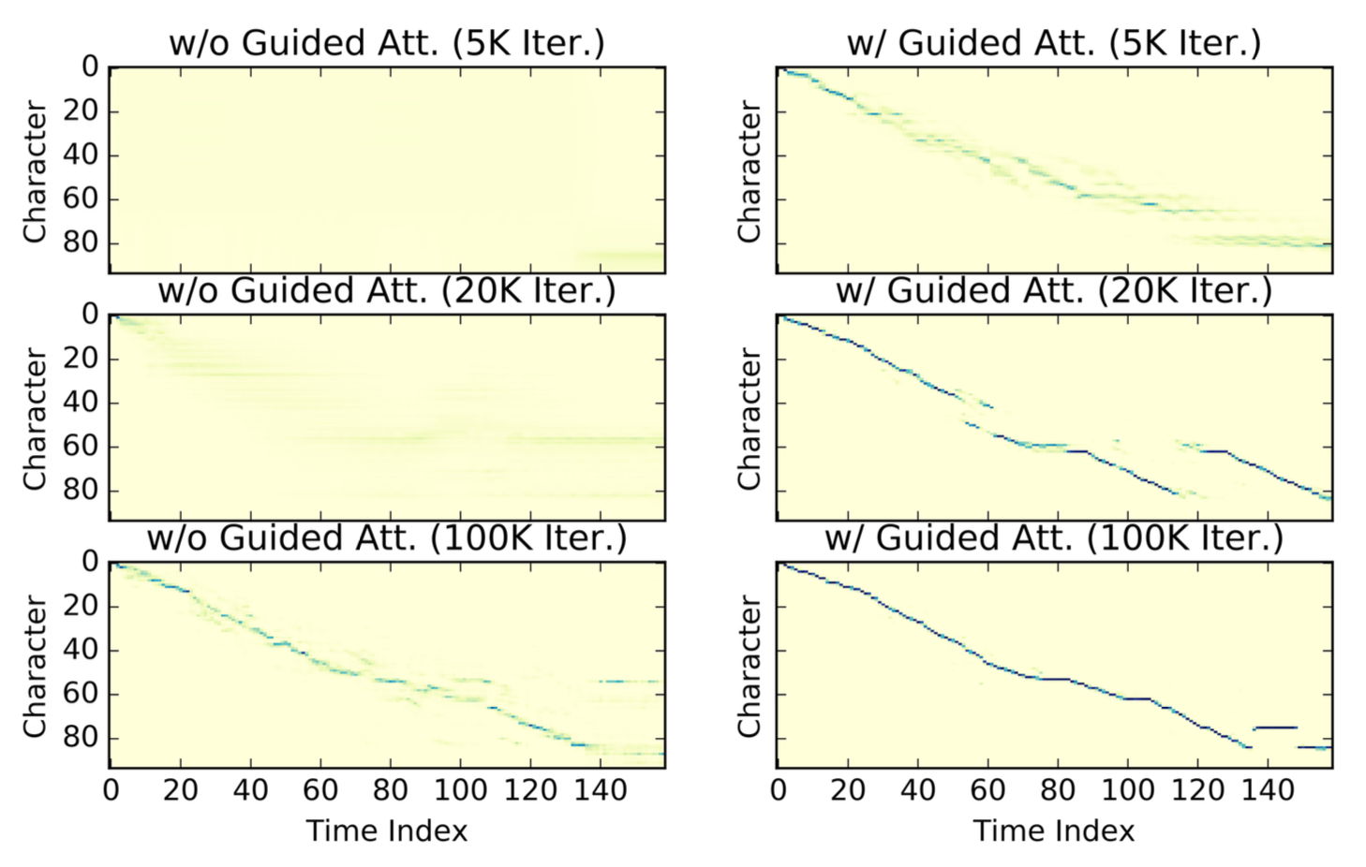
ALIGNMENT
Tacotron 2 : Guided attention
1. Motivation: The Alignment Bottleneck
Problem: Pure end-to-end attention takes tens of thousands of steps to learn monotonic alignment from scratch, often causing word skipping or repeating.
Solution: Introduce a soft diagonal prior L_{att} to guide attention learning during early training stages.
2. Mathematical Formulation & Intuition
Normalized text position and acoustic time progress roughly together.
Penalty Matrix W_{nt}:
  On-diagonal (n/N ≈ t/T): W_{nt} → 0 → No penalty.
  Off-diagonal (Far from diagonal): W_{nt} → 1 → High penalty.
Bandwidth Hyperparameter g: Controls the flexibility allowance for pauses and varying speech rates.
19 / 61
Notes:
[Sources]
- User-provided outline: week9 TTS 大纲.docx
- User-provided reference deck and diagrams: week 9 _ Classical TTS.pptx
- Guided Attention, arXiv:1906.00672

Slide 20
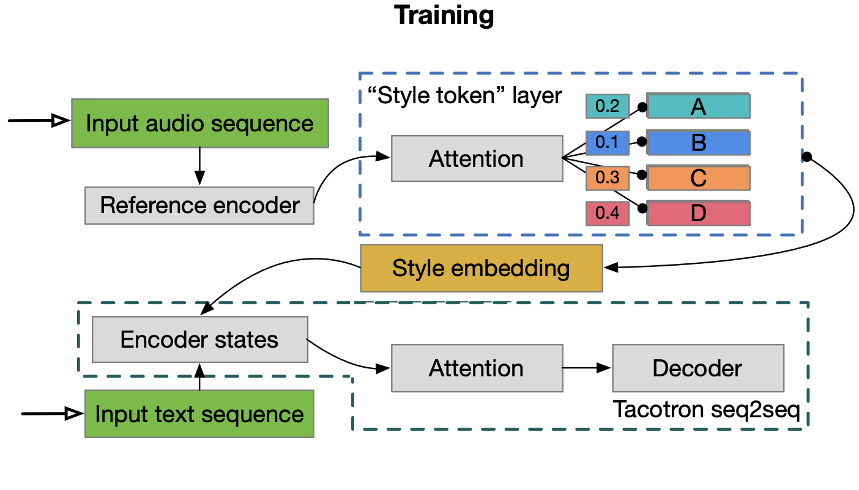
STYLE & SPEAKER
Tacotron 2 : Global Style Tokens (GST) - Training Phase
The one-to-many problem
A single text input corresponds to multiple valid audio outputs with varying pitch, pace, energy, and emotion. Text alone lacks acoustic variation details.
GST Core Training Workflow
1. Reference Encoder
Extracts a fixed-length Reference Embedding from variable-length target audio.
2. Style Token Layer
Maintains a bank of K learnable embeddings (Tokens A, B, C...).
Uses Multi-Head Attention to calculate similarity weights between Ref Embedding and Tokens.
3. Conditioning the Decoder
Multiplies weights with tokens to form the final Style Embedding.
Concatenated/added to text encoder outputs to guide speech generation.
20 / 61
Notes:
[Sources]
- User-provided outline: week9 TTS 大纲.docx
- User-provided reference deck and diagrams: week 9 _ Classical TTS.pptx
- Global Style Tokens, arXiv:1803.09017

Slide 21
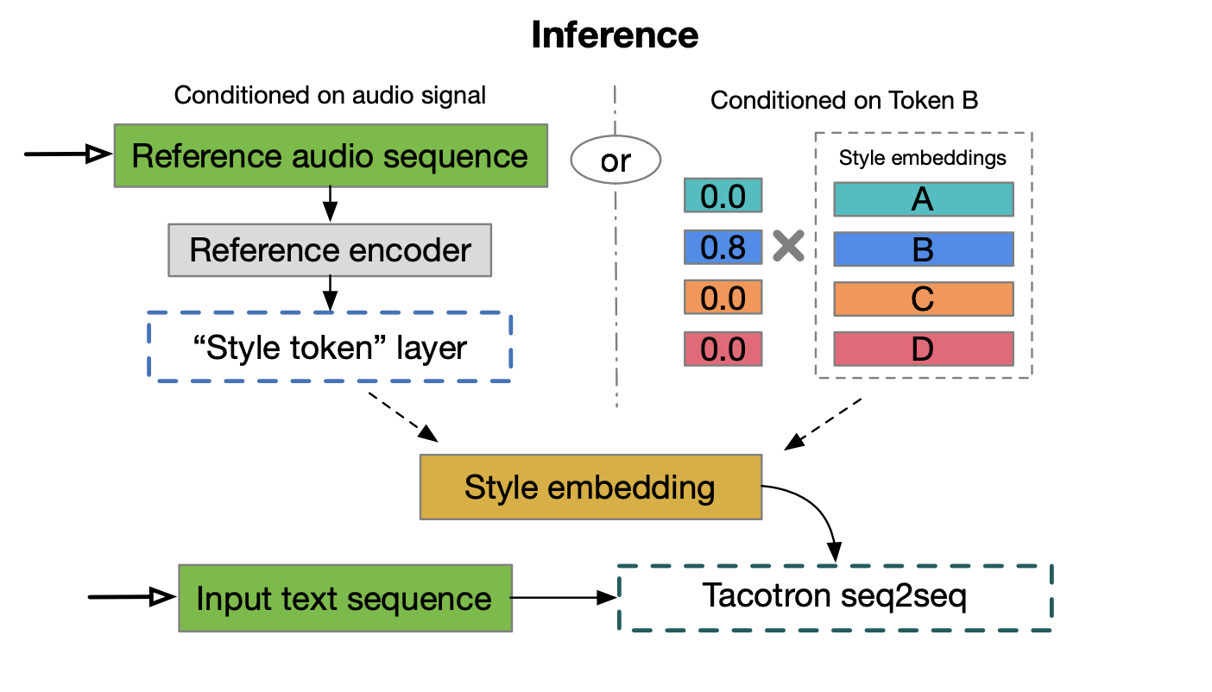
STYLE & SPEAKER
Tacotron 2 : Global Style Tokens (GST) - Inference & Limitations
Two control modes
• Reference audio: transfer a style without a label.
• Token weights: explore or reproduce a discovered style.
• Both paths produce a style embedding that enters the acoustic model.
Caveat
Unsupervised tokens are not guaranteed to map cleanly to human labels such as ‘happy’ or ‘sad’. Interpretability is empirical.
21 / 61
Notes:
[Sources]
- User-provided outline: week9 TTS 大纲.docx
- User-provided reference deck and diagrams: week 9 _ Classical TTS.pptx
- Global Style Tokens, arXiv:1803.09017

Slide 22
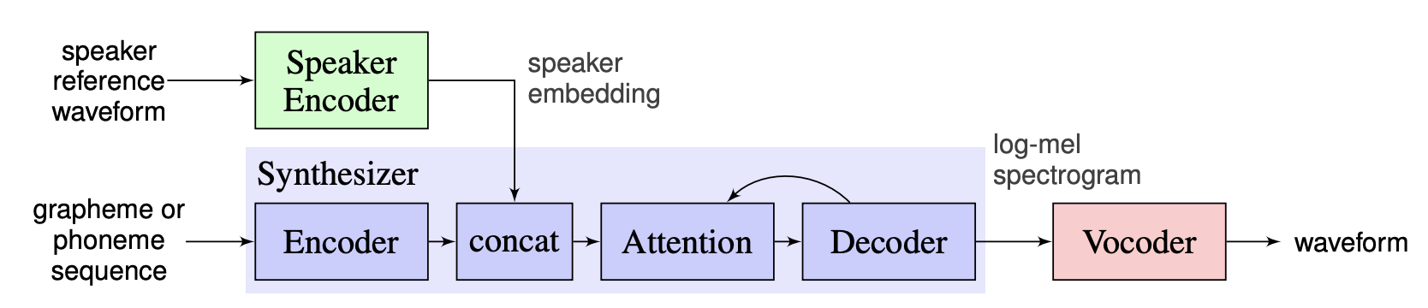
STYLE & SPEAKER
Multispeaker TTS
Speaker encoder (SE)
Text-independent Task
Trained on a speaker verification task.
Identity should survive content changes.
Map the voices of different people onto vectors that are vastly different from each other.
Extract the common and stable vocal characteristics that belong to the speaker.
22 / 61
Notes:
[Sources]
- User-provided outline: week9 TTS 大纲.docx
- User-provided reference deck and diagrams: week 9 _ Classical TTS.pptx

Slide 23
ACOUSTIC MODEL
Review and answers: acoustic modeling
1. Does location sensitivity guarantee monotonic alignment?
2. What previous frame is used at inference?
3. Are GST tokens fixed emotion labels?
23 / 61
Notes:
Location-sensitive attention supplies position-aware features without guaranteeing monotonic alignment. In inference the generated mel frame becomes the next input after the initial GO frame. GST tokens acquire meanings through learning rather than being fixed emotion labels. These answers distinguish useful inductive biases from absolute guarantees.

Slide 24
ACOUSTIC MODEL
Review and answers: acoustic modeling
1. Does location sensitivity guarantee monotonic alignment?
No. It supplies position-aware features, not a hard constraint.
2. What previous frame is used at inference?
The generated frame, after the initial input.
3. Are GST tokens fixed emotion labels?
No. Their meanings are learned and need inspection.
24 / 61
Notes:
Location-sensitive attention supplies position-aware features without guaranteeing monotonic alignment. In inference the generated mel frame becomes the next input after the initial GO frame. GST tokens acquire meanings through learning rather than being fixed emotion labels. These answers distinguish useful inductive biases from absolute guarantees.

Slide 25
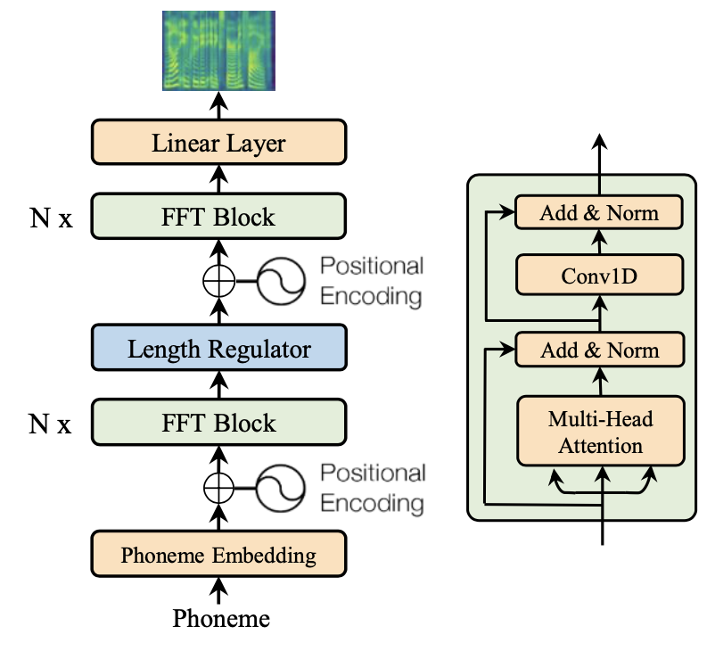
ACOUSTIC MODEL
Acoustic Model : FastSpeech (Non-Autoregressive TTS)
Tacotron 2
FastSpeech
• Frame-by-frame decoding
• Implicit Attention alignment
• Slower, vulnerable to skipping/repetition
• Parallel Mel Generation
• Explicit Duration-based Alignment
• Extremely fast (~30x+), robust & controllable
Key Architectural Components
1. Feed-Forward Transformer (FFT) Block
• Replaces RNNs with 1D Convolutions + Multi-Head Self-Attention for massive parallelism
2. Duration Predictor
• Predicts frame-level duration for each phoneme (trained on Teacher attention weights)
3. Length Regulator (The Core Innovation)
• Expands phoneme sequence (N) to match audio frame length (T) based on duration predictions.
25 / 61
Notes:
[Sources]
- User-provided outline: week9 TTS 大纲.docx
- User-provided reference deck and diagrams: week 9 _ Classical TTS.pptx
- FastSpeech, arXiv:1905.09263

Slide 26
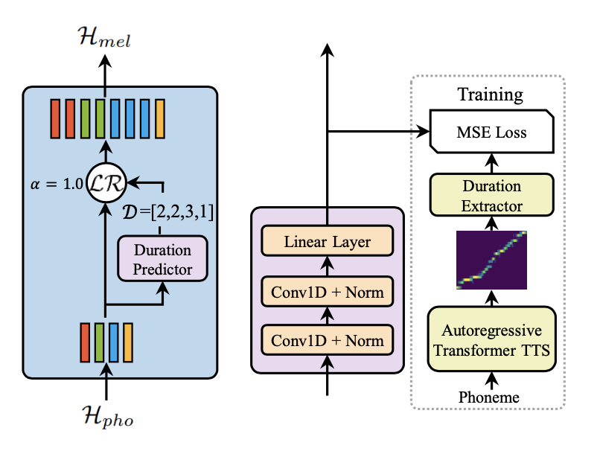
ACOUSTIC MODEL
FastSpeech : Duration Predictor & Length Regulator
Duration predictor
• Predict a duration d_{i} for each phoneme.
e.g. D = [2, 2, 3, 1], indicating that the first phoneme lasts for 2 frames, the second for 2 frames, the third for 3 frames, and the fourth for 1 frame.
• Use aligned targets during training.
• At inference, predicted durations determine output length.
Length regulator
• A parameterless module that merely performs the "copy" operation.
e.g.
h_phone = [a, b, c]
d = [2, 1, 3]
h_frame = [a, a, b, c, c, c]
26 / 61
Notes:
[Sources]
- User-provided outline: week9 TTS 大纲.docx
- User-provided reference deck and diagrams: week 9 _ Classical TTS.pptx
- FastSpeech, arXiv:1905.09263

Slide 27
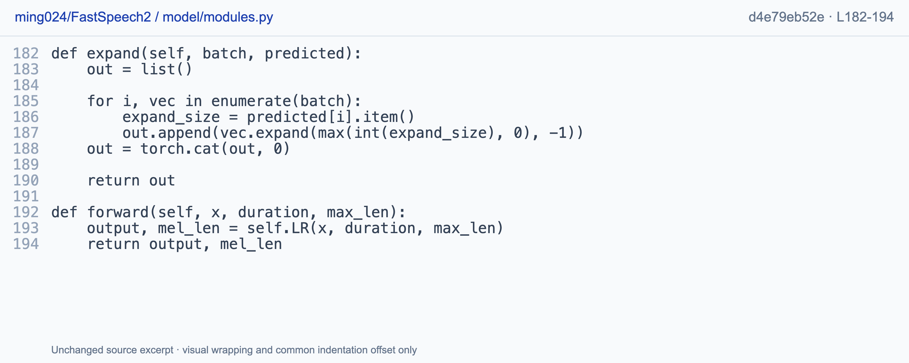
DURATION AND ALIGNMENT
Code: Duration-based expansion
One utterance [N,H] + durations [N] -> [sum(d),H]. Durations are frame counts, not seconds.
Chung-Ming Chien · ming024/FastSpeech2 · MIT · modules.py L182-194 · d4e79eb52e · independent implementation
27 / 61
Notes:
For one utterance, the expansion loop receives N hidden vectors and N durations, repeats each vector a nonnegative integer number of times, and concatenates the result. The output has sum-of-durations frames with unchanged hidden width. Durations here are frame counts rather than seconds. This is Chung-Ming Chien's independently maintained MIT reference implementation, not original-paper official code: https://github.com/ming024/FastSpeech2/blob/d4e79eb52e8b01d24703b2dfc0385544092958f3/model/modules.py#L182-L194.

Slide 28
ACOUSTIC MODEL
FastSpeech : Training Paradigm & Trade-offs
Teacher TTS
Attention map
Durations
FastSpeech
Parallel mel
Teacher-Student Distillation Mechanism
Trade-off: Pros vs. Cons
Offline Teacher Guidance
A pre-trained Autoregressive Teacher supplies explicit alignment maps and target mel-spectrograms.
Student Learning (FastSpeech)
FastSpeech learns deterministic duration prediction and feature mapping directly from the teacher.
Pros (Inference Gains)
No dynamic attention computation at inference.
Enables fully parallel, deterministic length expansion & ultra-fast synthesis.
Cons (Training Trade-offs):
Complex two-stage training pipeline.
Performance is upper-bounded by the quality of the Teacher's attention map.
28 / 61
Notes:
[Sources]
- User-provided outline: week9 TTS 大纲.docx
- User-provided reference deck and diagrams: week 9 _ Classical TTS.pptx
- FastSpeech, arXiv:1905.09263

Slide 29
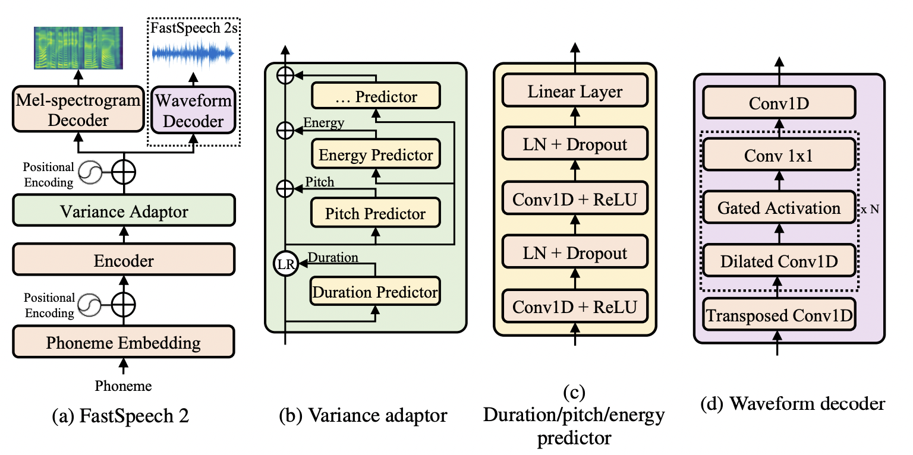
ACOUSTIC MODEL
FastSpeech 2: Explicit Variance Adaptation
Motivation: ResolvingOne-to-many mapping
The same phoneme string can be spoken slowly, quickly, softly, loudly, or with different intonation.
1. Variance adaptor
• Duration controls rhythm.
• Pitch controls intonation and melody.
• Energy controls loudness and emphasis.
2. Duration/Pitch/Power Predictor
• Similar structure (consisting of several layers of 1D Conv)
• Sharing the output of the encoder,but each independently predicts three different numerical sequences
29 / 61
Notes:
[Sources]
- User-provided outline: week9 TTS 大纲.docx
- User-provided reference deck and diagrams: week 9 _ Classical TTS.pptx
- FastSpeech 2, arXiv:2006.04558

Slide 30
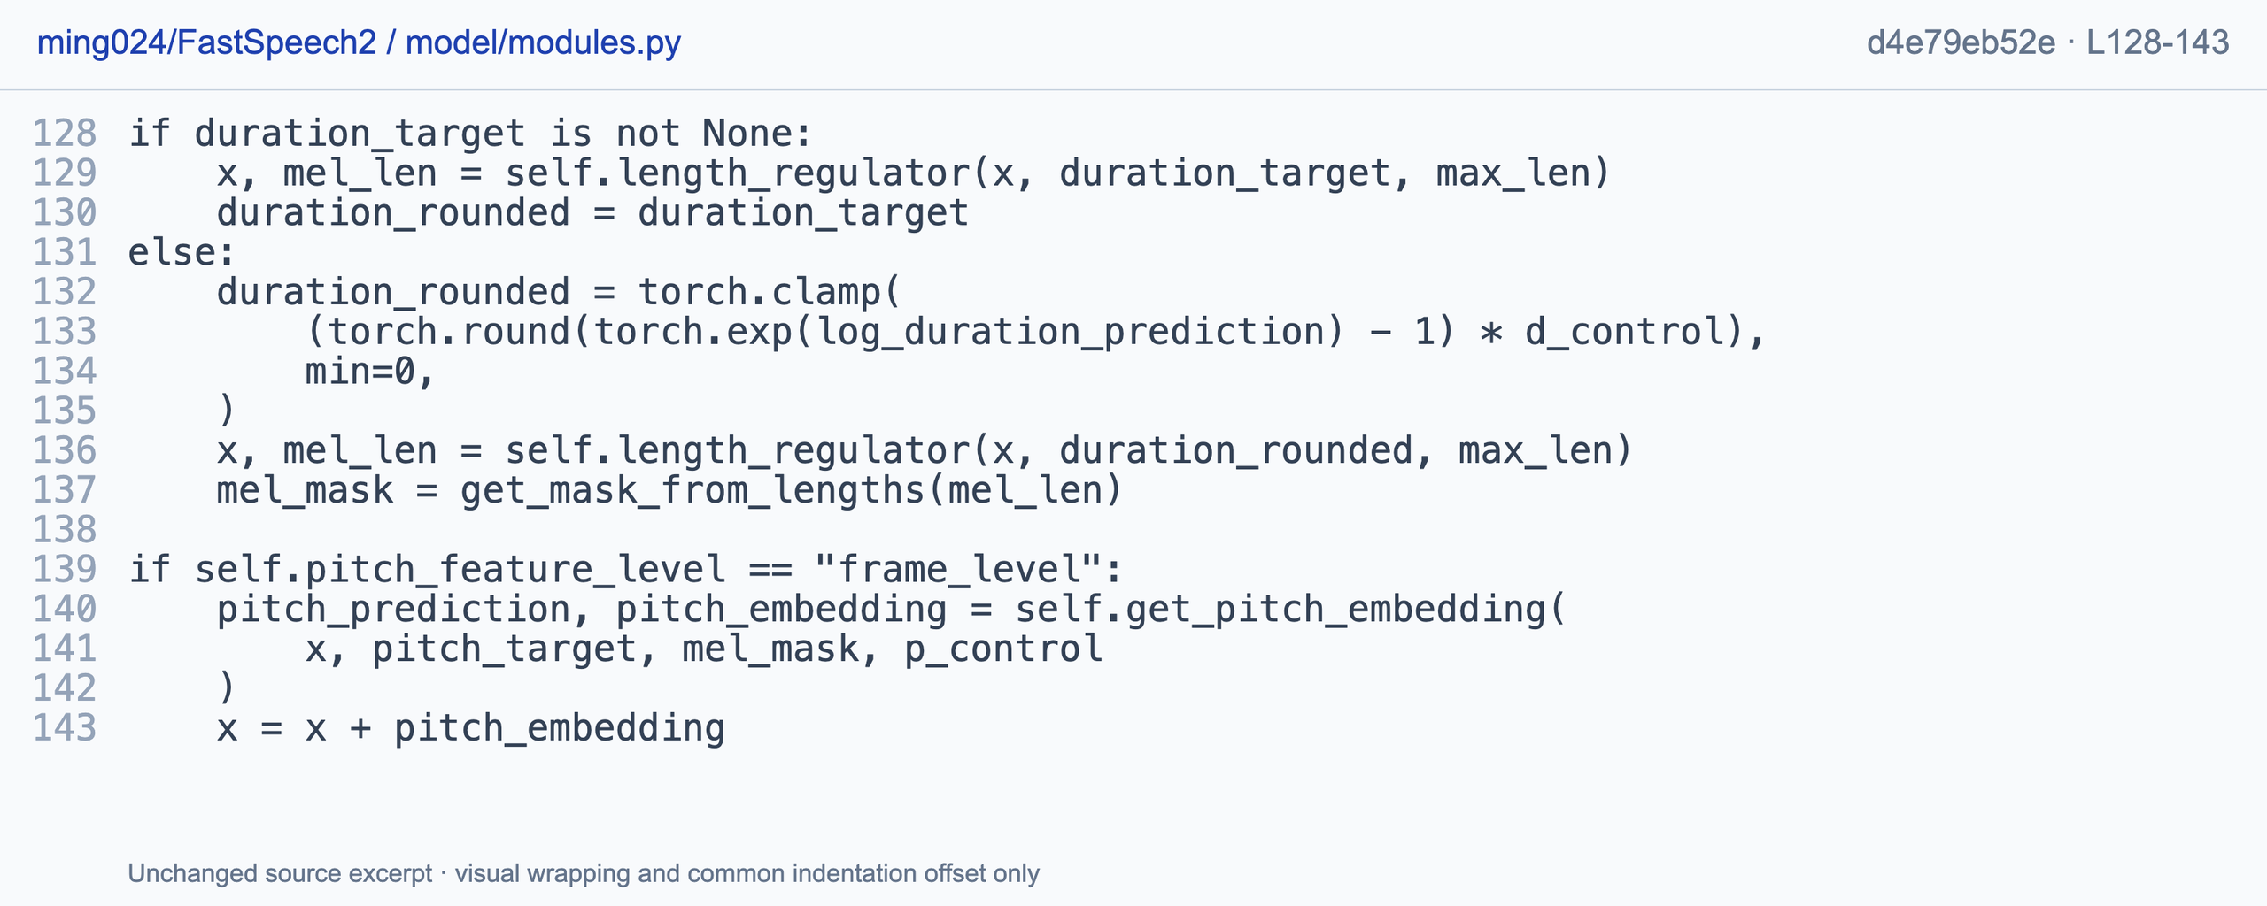
DURATION AND ALIGNMENT
Code: Targets vs. Predicted Duration & Pitch Addition
[B,N,H] -> [B,T,H]. Target or predicted duration expands x; frame-level pitch can then be added.
Chung-Ming Chien · ming024/FastSpeech2 · MIT · modules.py L128-143 · d4e79eb52e · independent F0-style code
30 / 61
Notes:
The excerpt chooses target durations when provided, otherwise transforms log-duration predictions, rounds and clamps them, and passes them to the length regulator. This changes a batch of text-length states into frame-length states. A frame-level pitch embedding can then be added. The shown independent F0-style implementation should not be treated as the original paper's full pitch representation: https://github.com/ming024/FastSpeech2/blob/d4e79eb52e8b01d24703b2dfc0385544092958f3/model/modules.py#L128-L143.

Slide 31
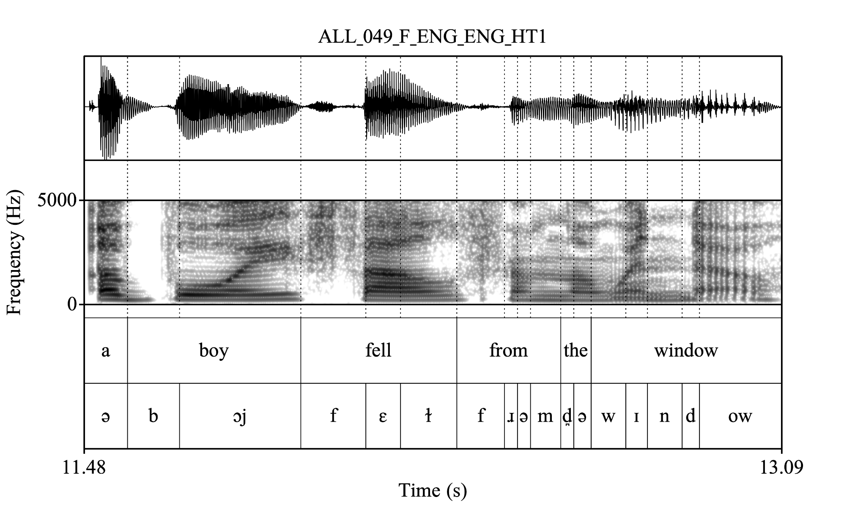
ALIGNMENT
Montreal Forced Aligner (MFA)
MFA Working Principle
Acoustic Feature Extraction
• Extract MFCC-like acoustic features.
• Use a GMM-HMM / pronunciation model.
Forced Alignment Search
• Search for the most probable state path under the transcript.
• Multi-pass optimization for speaker adaptation.
31 / 61
Notes:
[Sources]
- User-provided outline: week9 TTS 大纲.docx
- User-provided reference deck and diagrams: week 9 _ Classical TTS.pptx
- Montreal Forced Aligner, Interspeech 2017

Slide 32
DURATION AND ALIGNMENT
Review: alignment and controllability
Sequence length, module boundary, guarantees
1. Expand [a,b,c] with durations [1,3,2].
2. Is the length regulator after the entire variance adaptor?
3. Does a duration model guarantee that words are never skipped?
32 / 61
Notes:
Expand the three states using durations one, three and two, then identify where the regulator belongs relative to the variance adaptor. Finally, consider whether explicit durations can guarantee that words are never skipped. These checks address sequence length, module boundaries and the limits of controllability.

Slide 33
DURATION AND ALIGNMENT
Reference answers: alignment
Explicit lengths improve control, not absolute correctness
1. Expand [a,b,c] with durations [1,3,2].
[a,b,b,b,c,c], giving six frames.
2. Is the length regulator after the entire variance adaptor?
No. The length regulator is a component inside the variance adaptor.
3. Does a duration model guarantee that words are never skipped?
No. Frontend mistakes, duration errors, zero durations and acoustic failures can still reduce intelligibility.
33 / 61
Notes:
The expansion is a, b, b, b, c, c, giving six frames. The length regulator is a component inside the variance adaptor. Explicit duration control does not guarantee intelligibility: frontend mistakes, zero or incorrect durations and acoustic failures can still damage the utterance.

Slide 34
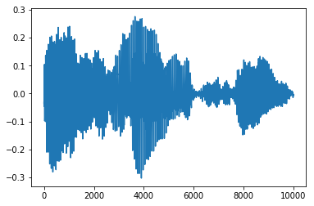
VOCODERS
Vocoder : Mel-Spectrogram to Waveform Synthesis
1. Task Pipeline:
Vocoder
Mel spectrogram
audio waveform
2. Core Question: What Must Be Reconstructed?
1. Phase Information & Fine Timing
Mel-spectrograms throw away phase information; the vocoder must recover phase to generate natural time-domain signals.
2. Harmonic Structure
Restructures pitch periodicity, pitch harmonics, and clear fundamental frequencies
3. Transient Consonants
Accurately synthesizes high-frequency noise and unvoiced plosive/fricative sounds.
4. Natural Stochastic Details
Fills in realistic background breathiness, environmental subtle noise, and acoustic texture.
34 / 61
Notes:
[Sources]
- User-provided outline: week9 TTS 大纲.docx
- User-provided reference deck and diagrams: week 9 _ Classical TTS.pptx

Slide 35
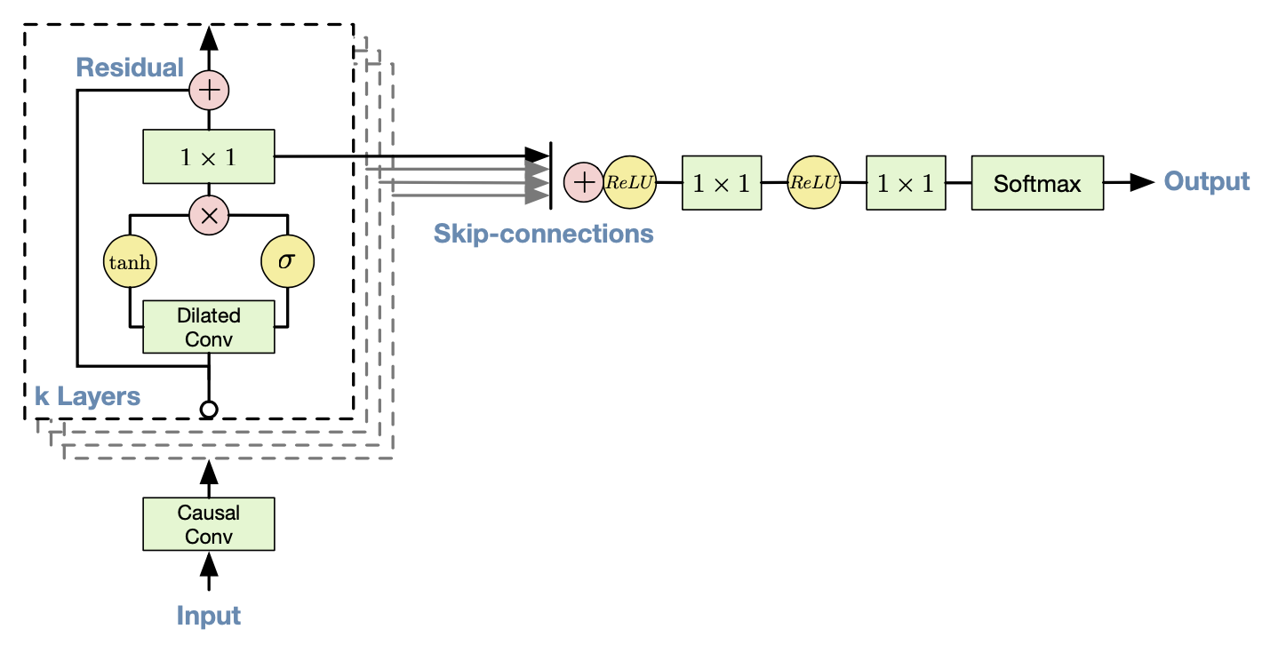
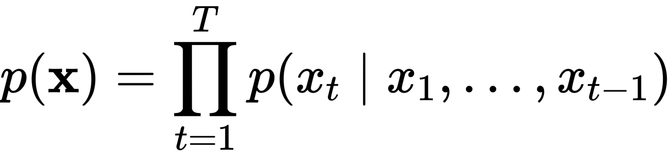
VOCODER
WaveNet : Autoregressive Audio Generation
1. Probabilistic Modeling & Formula
(1) Autoregressive Formulation
Joint probability of audio waveform x = {x₁, x₂, ..., x_{T}} is factorized into conditional probabilities:
Each audio sample x_{t} is strictly conditioned on all previously generated samples.
(2) Quantized Categorical Output
Predicts a discrete probability distribution via Softmax:
2. Core Architectural Modules
(1) Causal Convolutions
(2) Dilated Convolutions
Quantizes 16-bit audio into 256 discrete values using mu-law companding algorithm.
(3) Gated Activation Units
(4) Residual & Skip Connections
35 / 61
Notes:
WaveNet models the waveform as a product of conditional sample probabilities given previous samples and acoustic conditioning. Dilated causal convolution, gated activations, residual paths and skip connections support deep historical modeling. Original quantized outputs are categorical, although later variants can differ. Known histories permit parallel training computation, but generated histories create sequential inference. The source is original slide nineteen and https://arxiv.org/abs/1609.03499.

Slide 36
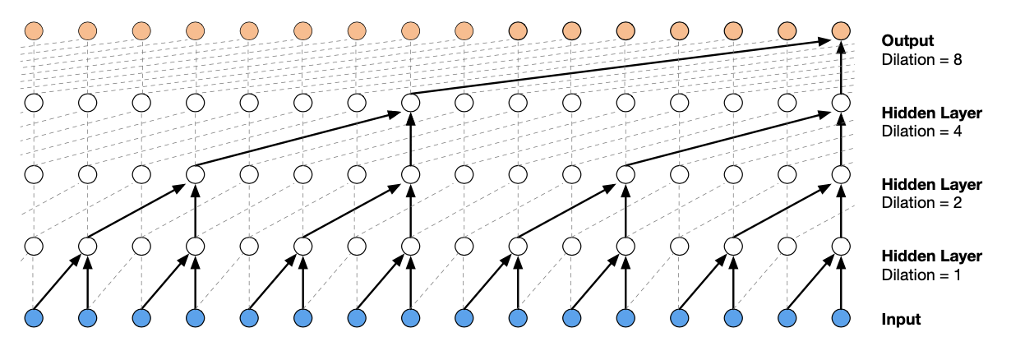
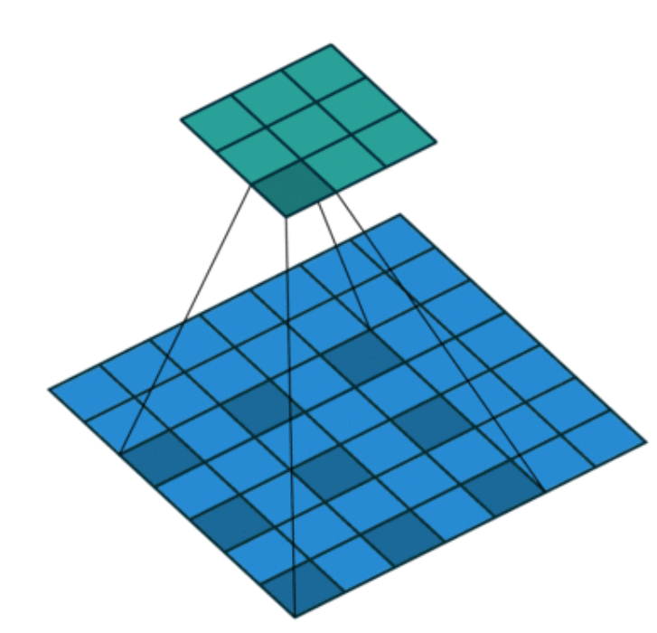
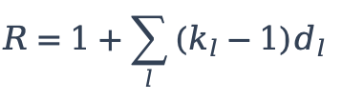
VOCODER
Dilated Causal Convolution : Expanding Receptive Field
Dual Mechanism Breakdown
Key Architectural Advantages
Causality: Ensures prediction at step t depends only on samples at t, t-1, t-2, ..., strictly avoiding future data leakage.
Increase receptive field.
Allow modeling long time dependencies.
Causal for avoiding looking in the future.
Dilated Rate Growth: Doubling dilation rates (d = 1, 2, 4, 8, ...) skips input values with a step size, letting the filter apply over a larger area.
Receptive Field Formula
The effective receptive field R across L layers is computed as:
$$R=1+\sum_{l}{\left(k_{l}−1\right)d_{l}}$$
36 / 61
Notes:
Dilation factors one, two, four and eight expand historical coverage while causality excludes future samples. For a stride-one chain, receptive field equals one plus the sum of kernel-size-minus-one multiplied by dilation at each layer. This relationship assumes the stated chain rather than arbitrary strided architectures. Correct target shifting is essential because causal padding alone does not prevent current-sample leakage. The supplied diagram is original course slide twenty.

Slide 37
VOCODER
Conditional WaveNet: Gated Activation Unit
Without acoustic conditioning
With local acoustic conditioning
Variable Notation
x: Hidden states of past audio waveform history.
y: Upsampled acoustic conditioning features.
W_{f,k}, W_{g,k}: Convolutional filter/gate weights for audio history.
V_{f,k}, V_{g,k}: Linear projection parameters for acoustic conditioning.
Dual-Branch Architecture
Filter Branch (tanh): Captures non-linear feature representations and acoustic transformations.
Gate Branch (sigma): Acts as a learnable element-wise memory gate (0 → 1), regulating information flow.
37 / 61
Notes:
The original equations from Classical TTS slide twenty-one compare a gate without acoustic conditioning with one that adds conditioning to both branches. The activation multiplies a tanh branch by a sigmoid branch elementwise. Each branch combines a learned projection of hidden waveform-history states x with a projection of upsampled acoustic conditioning y, denoted s elsewhere in this deck. Conditioning guides content while waveform generation remains autoregressive. The sigmoid controls learned features and should not be interpreted as a literal loudness switch.

Slide 38
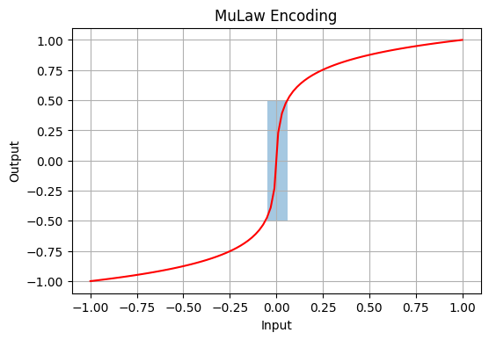
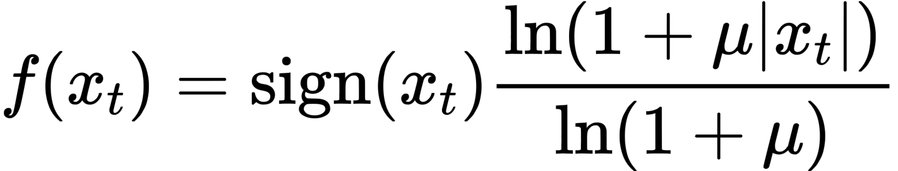
VOCODERS
μ-law Companding: Making Waveform Classification Tractable
Mathematical Definition
(Where μ = 255 to compress continuous amplitudes into 256 quantization bins).
Why Quantize & Compress?
Feasibility Challenge:
Standard 16-bit PCM WAV audio has 65,536 possible amplitude values per sample.
Tractable Classification:
Training a 256-way Softmax layer is computationally tractable and converges far easier than a 65,536-way Softmax.
Logarithmic Quantization:
Reallocates dense quantization levels where human perception needs them most.
Perceptual Link — Psychoacoustic Motivation
High Resolution for Low Amplitudes:
Human hearing is non-linear and far more sensitive to small amplitude variations in quiet sound segments.
Coarser Quantization for Loud Peaks:
High-amplitude peaks mask quantization noise, allowing coarser binning without perceptual degradation.
38 / 61
Notes:
[Sources]
- User-provided outline: week9 TTS 大纲.docx
- User-provided reference deck and diagrams: week 9 _ Classical TTS.pptx
- WaveNet, arXiv:1609.03499

Slide 39
VOCODERS
Vocoder Evolution : Improving Quality, Eliminating Serial Bottlenecks
Generation | Model | Conditioning | Speed profile | Key idea
1 | WaveNet | Past waveform | Very slow | Autoregressive waveform modeling
2 | Conditional WaveNet | Past waveform + mel | Very slow | Content-controlled vocoding
3 | Parallel WaveGAN | Noise + mel | Fast | GAN + multi-resolution STFT
4 | MelGAN / HiFi-GAN | Mel | Very fast | Multi-scale / multi-period discrimination
Core Transition: Shifted from Autoregressive (Sample-by-Sample) modeling to Non-Autoregressive GAN-based Parallel Generation.
39 / 61
Notes:
[Sources]
- User-provided outline: week9 TTS 大纲.docx
- User-provided reference deck and diagrams: week 9 _ Classical TTS.pptx
- WaveNet, arXiv:1609.03499
- Parallel WaveGAN, arXiv:1910.11480
- MelGAN, arXiv:1910.06711
- HiFi-GAN, arXiv:2010.05646

Slide 40
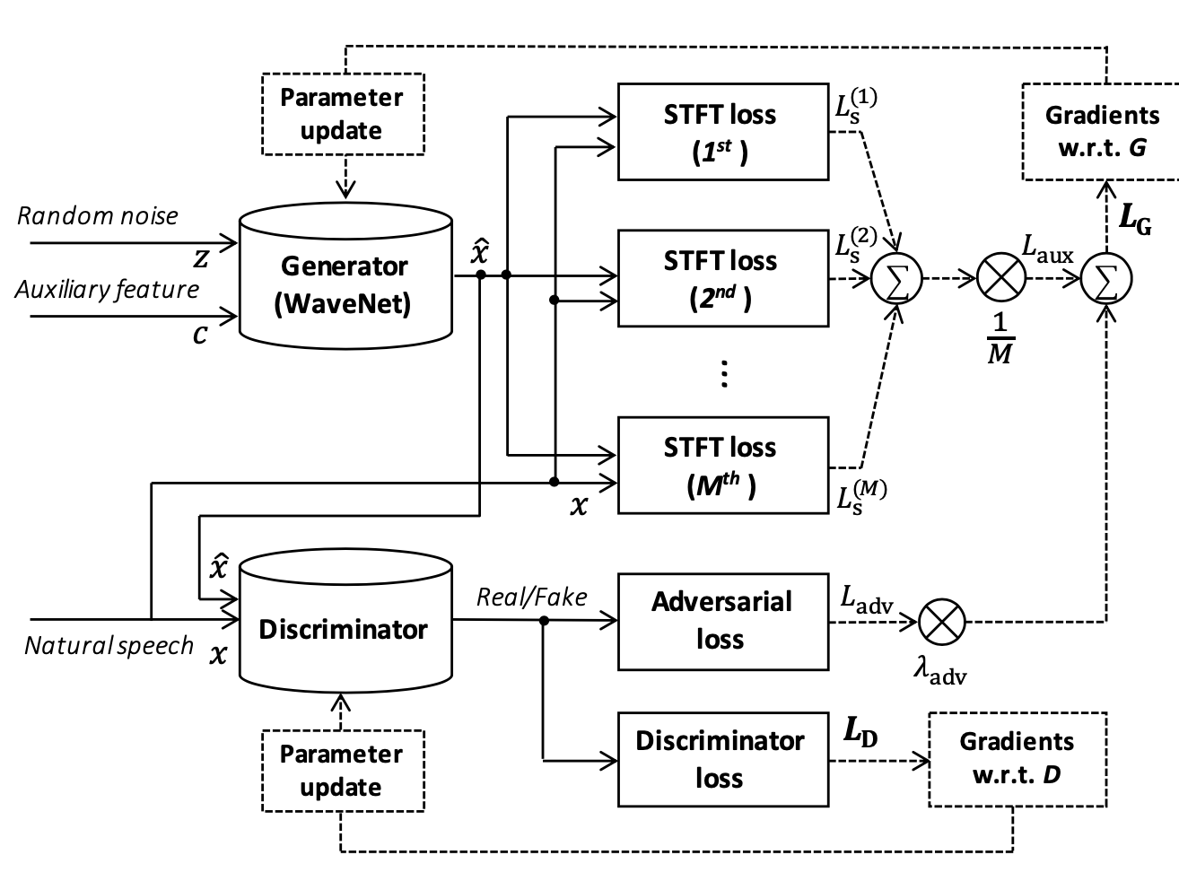
VOCODERS
Parallel WaveGAN : Non-Autoregressive Waveform Generation
Primary Problem Solved: Traditional WaveNet suffers from severe serial bottlenecks.
1. WaveNet-based Non-Autoregressive Generator
• Receives random noise and an auxiliary mel condition.
• Outputs the whole waveform in parallel.
• Uses a WaveNet-like stack without autoregressive sampling.
2. Additionally use Multi-STFT loss
• Remove the autoregressive mechanism
• Adopt GAN + STFT loss to ensure stable training and sound quality.
40 / 61
Notes:
[Sources]
- User-provided outline: week9 TTS 大纲.docx
- User-provided reference deck and diagrams: week 9 _ Classical TTS.pptx
- Parallel WaveGAN, arXiv:1910.11480

Slide 41
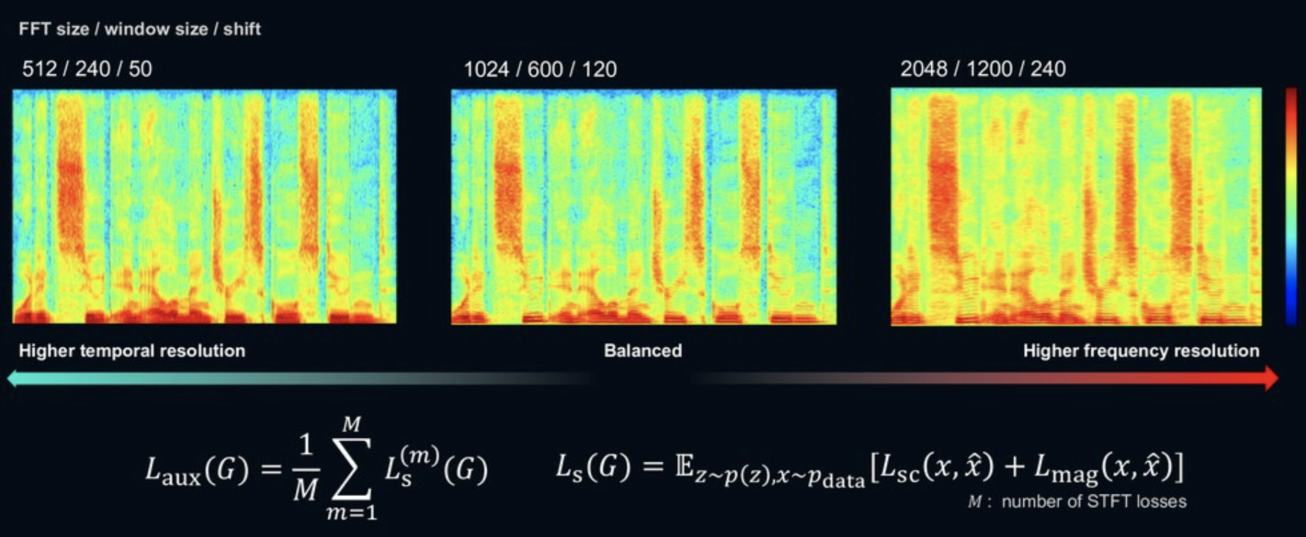
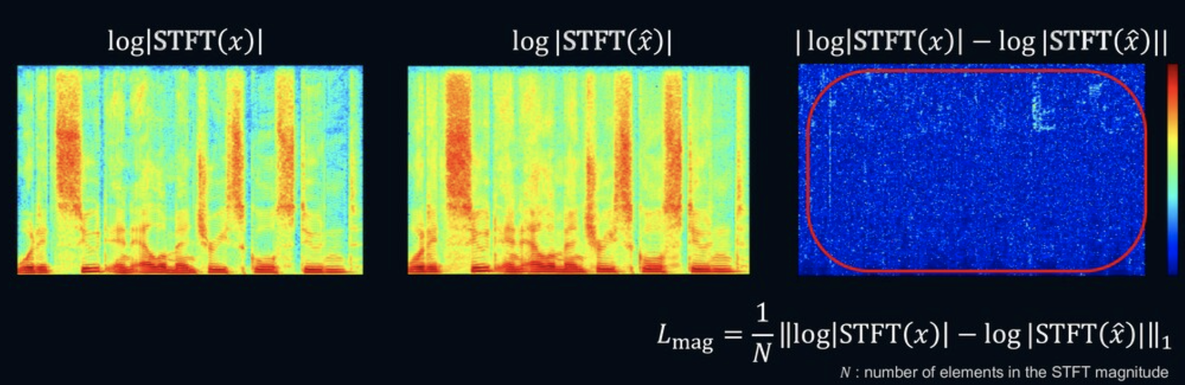
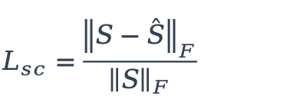
VOCODER
Multi-Resolution STFT Loss : Time-Frequency Balance
Several views of the same waveform
Short windows emphasize temporal detail.
Long windows emphasize frequency detail.
Average both loss terms across resolutions.
$$L_{sc}=\frac{{\left\|S−\overset{ˆ}{S}\right\|}_{F}}{{\left\|S\right\|}_{F}}$$
Two complementary spectral errors
Spectral convergence measures normalized overall Frobenius error.
Log-magnitude distance emphasizes relative differences in low-amplitude regions.
Numerical clamps prevent log-zero; analysis settings must be disclosed.
41 / 61
Notes:
The original illustrations from TTS_second slide forty compare STFT analysis settings and target, generated and error spectra. Short STFT windows emphasize temporal detail, while long windows improve frequency resolution. Spectral convergence normalizes the Frobenius norm of spectral error by the target norm, and log-magnitude loss averages absolute differences in log spectra. Average the two terms across resolutions to combine complementary information, including relative low-amplitude differences. Numerical clamps prevent logarithms of zero, and the analysis settings must be disclosed. The following code implements this resolution-by-resolution aggregation.

Slide 42
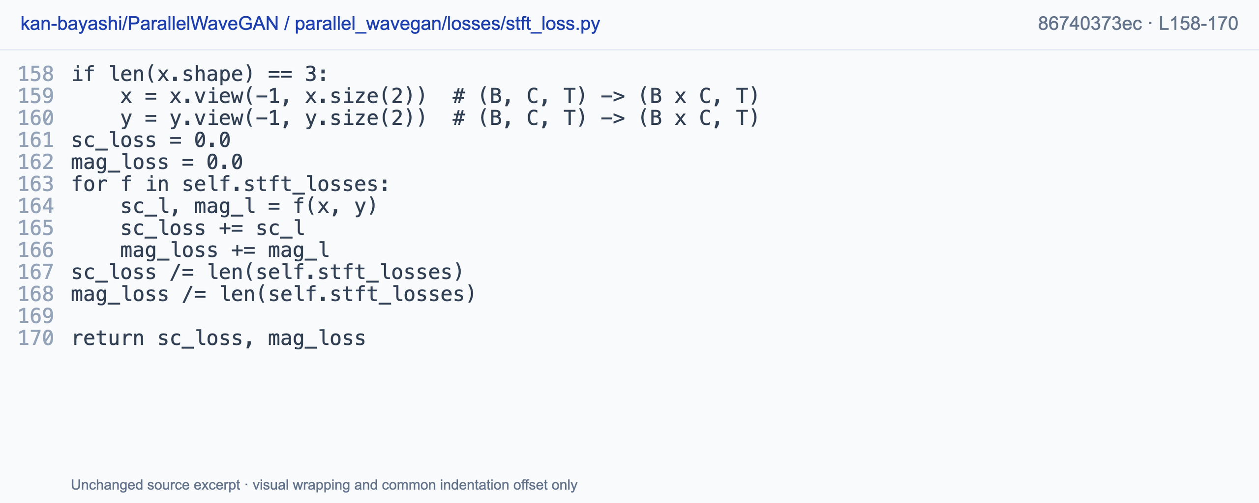
VOCODER
Code : Multi-Resolution STFT Loss Aggregation
Predicted and target audio -> two averaged scalars. Several analysis scales, not synthesized clips.
Tomoki Hayashi · kan-bayashi/ParallelWaveGAN · MIT · stft_loss.py L158-170 · 86740373ec · unofficial
42 / 61
Notes:
The code flattens batch and channel dimensions when needed, applies each configured STFT-loss module, and separately averages convergence and magnitude terms. Predicted and target audio produce two scalar losses, not synthesized clips at multiple resolutions. This is Tomoki Hayashi's explicitly unofficial community ParallelWaveGAN implementation under MIT: https://github.com/kan-bayashi/ParallelWaveGAN/blob/86740373ec609cb9fb192d472d2aea125041491a/parallel_wavegan/losses/stft_loss.py#L158-L170.

Slide 43
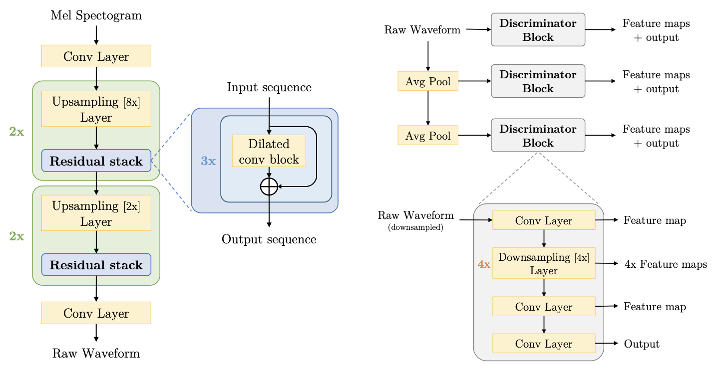
VOCODERS
MelGAN : Pure GAN-Based Non-Autoregressive Vocoder
Core Architectural Features
1. Fully Non-Autoregressive Synthesis
Synthesizes audio in a single forward pass without autoregressive loops or sequential bottleneck.
2. End-to-End Upsampling Pipeline
Uses transposed convolutions (upsampling layers) to bridge the time-resolution gap between low-frequency Mel frames and high-frequency audio waveforms.
3. Receptive Field Expansion
Integrates Residual Stacks with Dilated Convolutions after upsampling to expand effective receptive fields and capture long-range temporal context.
4. No Distillation Required
Directly trained end-to-end without needing teacher-student knowledge distillation or complex pre-training steps.
43 / 61
Notes:
[Sources]
- User-provided outline: week9 TTS 大纲.docx
- User-provided reference deck and diagrams: week 9 _ Classical TTS.pptx
- MelGAN, arXiv:1910.06711

Slide 44
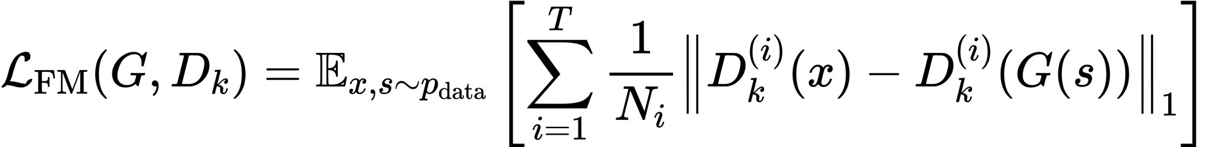
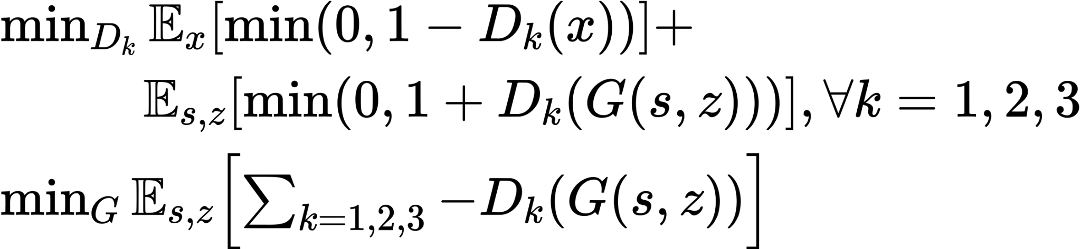
VOCODERS
MelGAN : Multi-Scale Discriminator & Feature Matching
Multi-scale discriminator
Feature matching
• Different pooling scales inspect different temporal structure.
• The generator cannot win by matching only one resolution.
• Match intermediate discriminator features.
• Reduces mechanical artifacts and unstable training.
44 / 61
Notes:
[Sources]
- User-provided outline: week9 TTS 大纲.docx
- User-provided reference deck and diagrams: week 9 _ Classical TTS.pptx
- MelGAN, arXiv:1910.06711

Slide 45
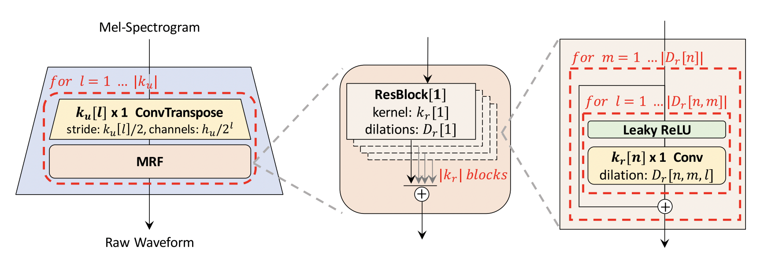
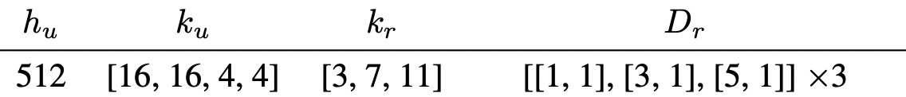
VOCODER
HiFi-GAN Generator : Multi-Receptive Field Fusion (MRF)
Overall Generator Pipeline & Innovation
MRF ResBlock Architecture Details
Transposed Convolution Upsampling
Progressive upsampling via k_{u} = [16, 16, 4, 4] layers to match the target sample rate.
Hyperparameter Configuration:
h_{u}= 512: Initial hidden feature dimension.
k_{u}: kernel size of upsampling
k_{r}= [3, 7, 11]: Parallel ResBlock kernel sizes (small, medium, large receptive fields).
D_{r}= [[1, 1], [3, 1], [5, 1]] x 3: Layered dilation rates expanding temporal fields without sparse holes.
Multi-Receptive Field Integration (MRF)
Instead of a single residual chain, HiFi-GAN processes features through multiple parallel ResBlocks with different kernel sizes (k_{r})and dilation rates(D_{r}).
Sums the outputs of all parallel ResBlocks to synthesize rich harmonic patterns.
45 / 61
Notes:
HiFi-GAN combines temporal upsampling with multi-receptive-field residual processing. In author configuration V1, strides eight, eight, two and two multiply to two hundred and fifty-six samples per mel frame, matching the mel hop. Kernels sixteen, sixteen, four and four describe filter support rather than expansion rates. MRF combines branches with different kernel and dilation settings before the final mono projection, and other configurations differ. The figure is original slide twenty-seven, with configuration at https://github.com/jik876/hifi-gan/blob/4769534d45265d52a904b850da5a622601885777/config_v1.json.

Slide 46
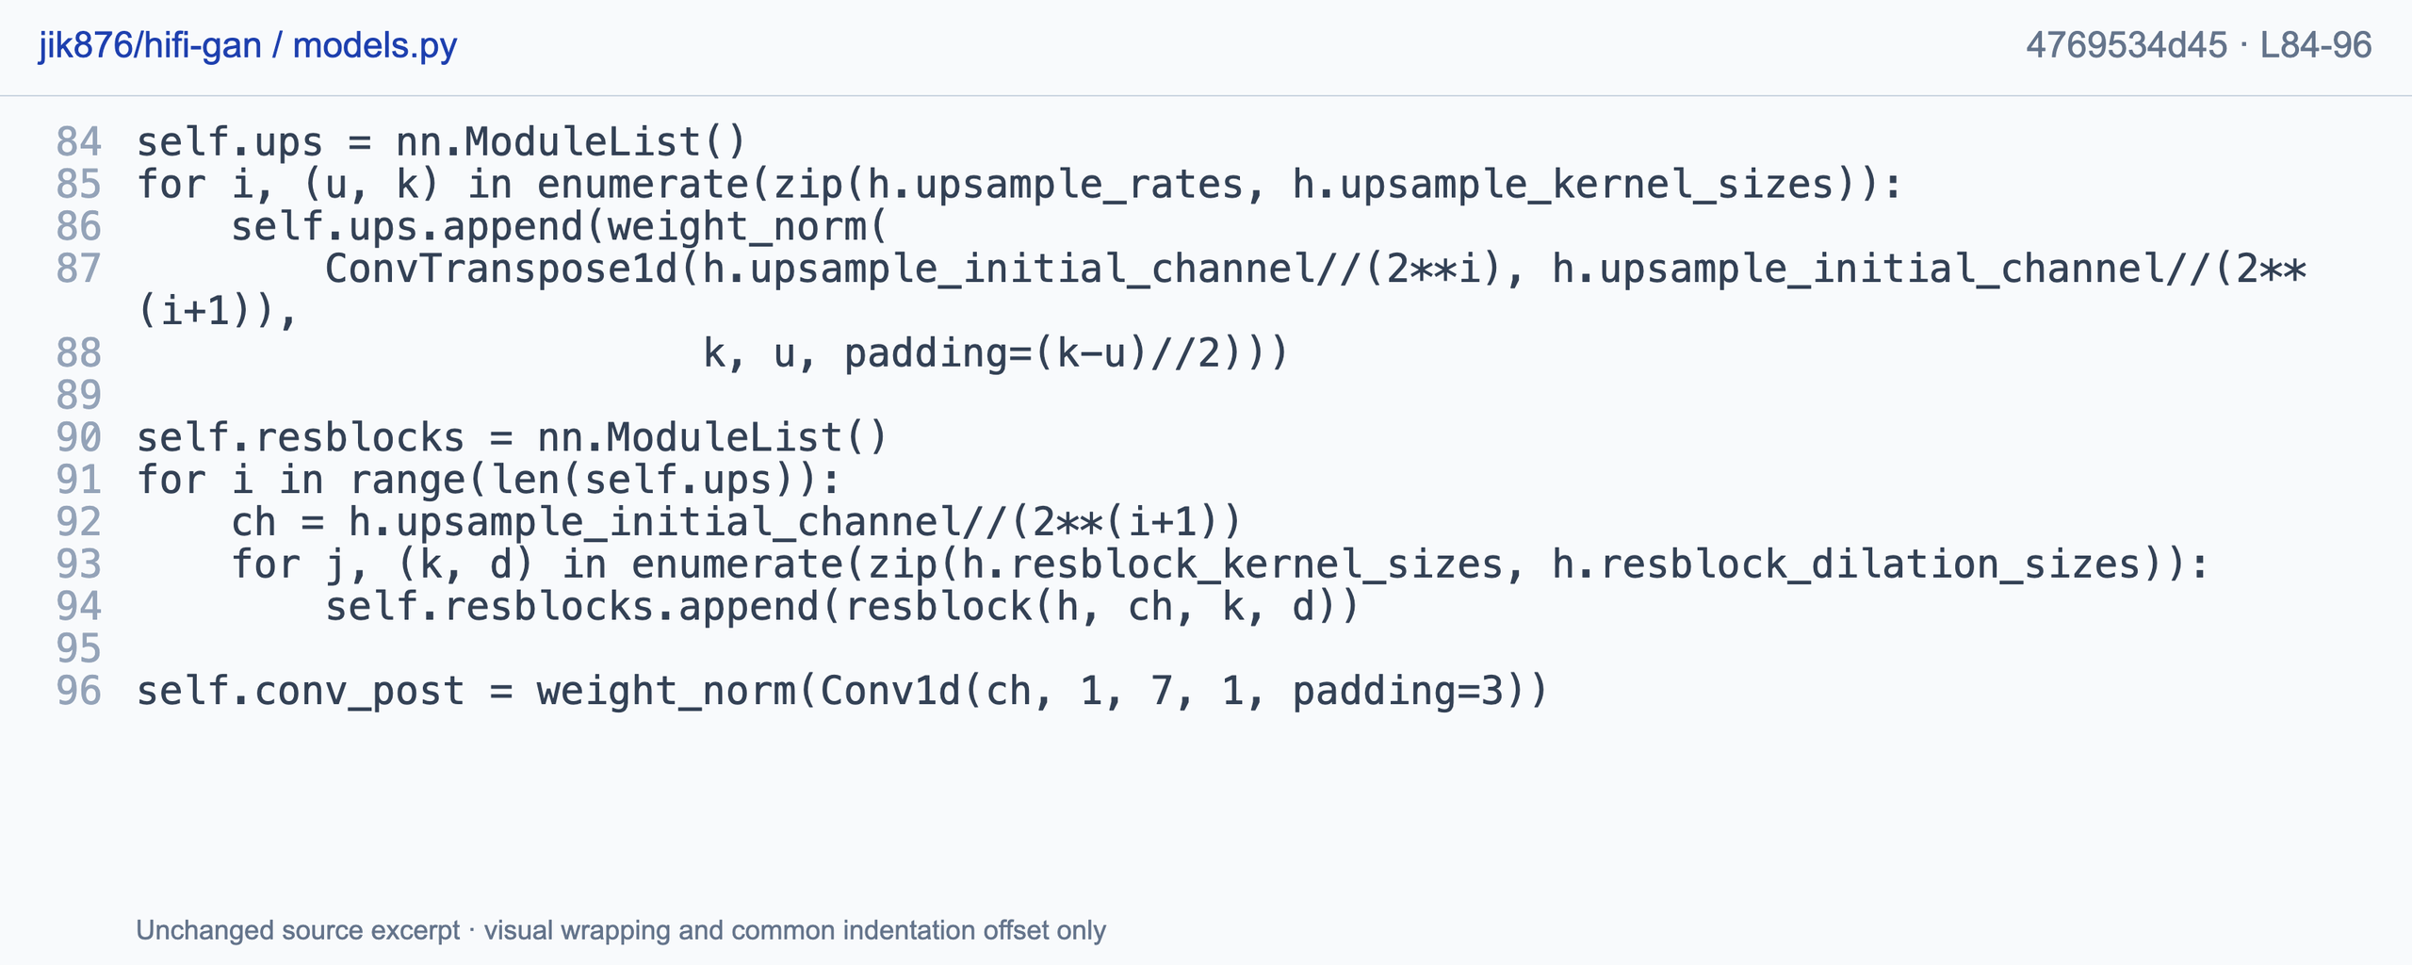
VOCODER
Code: upsampling kernels and strides
Mel features -> longer hidden sequence. Stride sets expansion; kernel sets support; padding sets exact length.
Jungil Kong · jik876/hifi-gan · MIT · models.py L84-96 · 4769534d45 · author code
46 / 61
Notes:
The constructor pairs each upsampling rate with its kernel size. ConvTranspose1d stride determines temporal expansion, its kernel determines filter support, and padding affects exact length, while channels shrink across stages. The rate product must match the expected samples-per-frame interface. The author MIT excerpt is https://github.com/jik876/hifi-gan/blob/4769534d45265d52a904b850da5a622601885777/models.py#L84-L96.

Slide 47
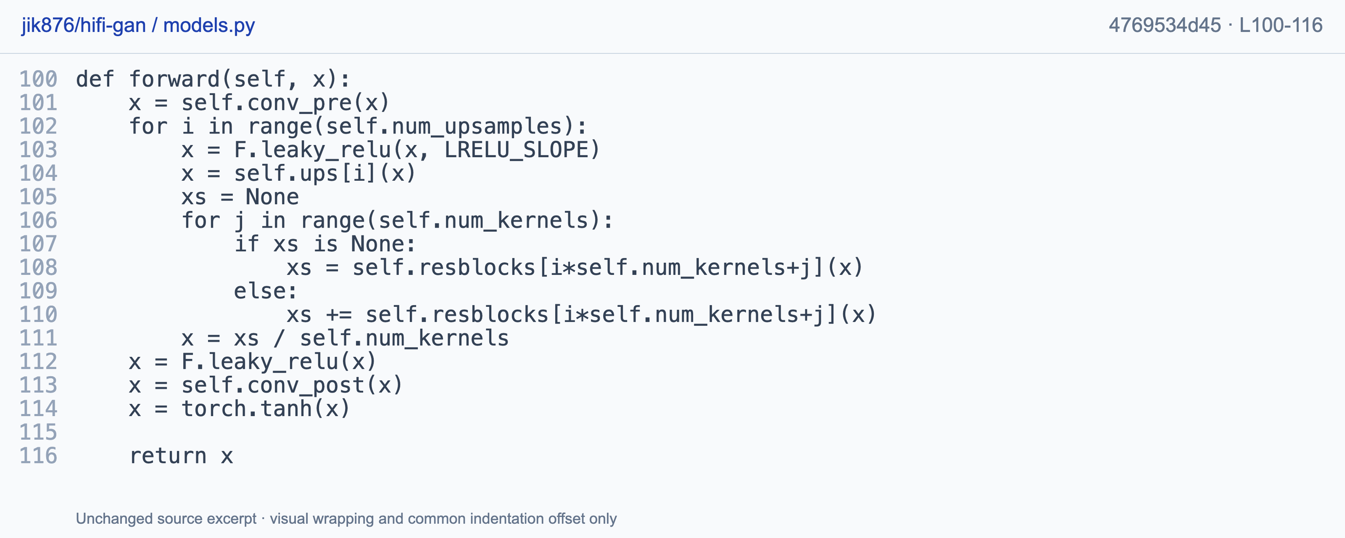
VOCODER
Code: multi-receptive-field fusion
Shared upsampled features -> averaged residual branches -> bounded mono waveform. Not mixed speech clips.
Jungil Kong · jik876/hifi-gan · MIT · models.py L100-116 · 4769534d45 · author code
47 / 61
Notes:
After each upsampling stage, several residual blocks process the same hidden features. Their outputs accumulate and divide by the number of kernels, demonstrating multi-receptive-field fusion rather than mixing separate speech clips. Final projection and tanh produce a bounded mono waveform. The author source is https://github.com/jik876/hifi-gan/blob/4769534d45265d52a904b850da5a622601885777/models.py#L100-L116.

Slide 48
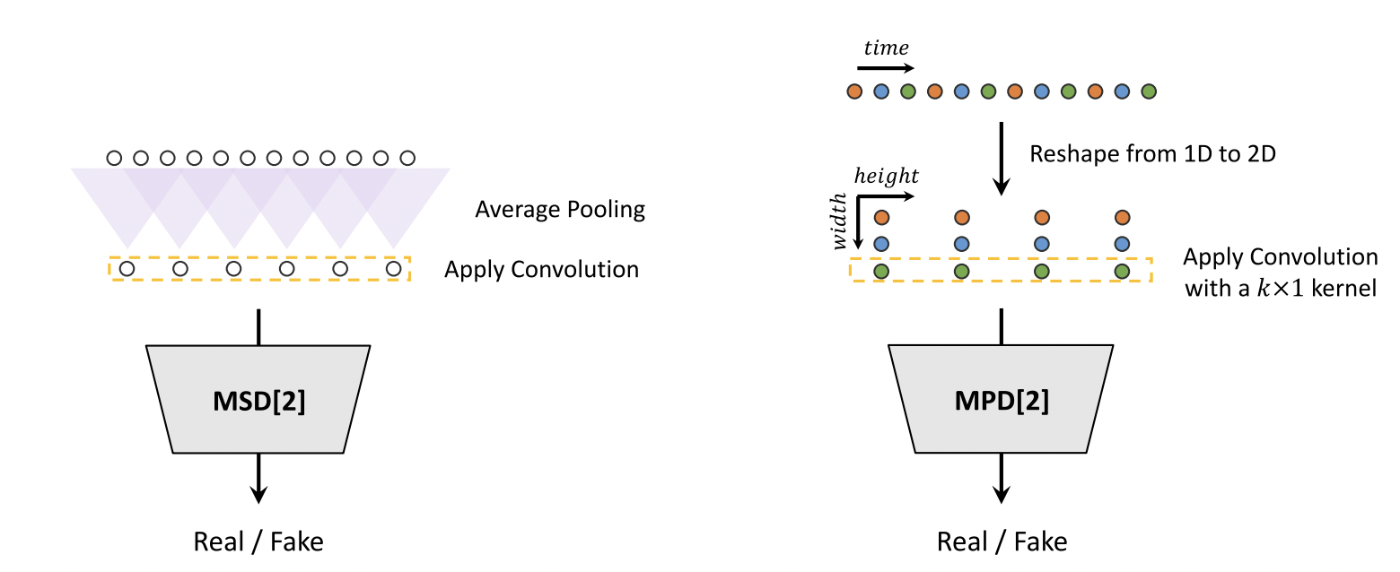
VOCODER
Multi-Scale (MSD) vs. Multi-Period (MPD) Discriminators
Temporal Resolution View
Downsamples raw 1D audio via Average Pooling.
Uses 1D Conv to inspect consecutive audio samples at coarse, medium, and fine scales.
Harmonic Pitch Periodicity View
Folds 1D audio into 2D tensor of shape [T/p, p].
Uses 2D Conv with k x 1 kernels along the period dimension p.
Primary Objective
Evaluates temporal smoothness, long-term trends, and phase consistency across raw waveforms.
Primary Objective
Captures pitch, fundamental frequencies (F0), and disjoint harmonic structures associated with period p.
48 / 61
Notes:
The supplied original slide twenty-eight distinguishes two analysis views. Multi-scale discriminators inspect raw and average-pooled waveforms, while multi-period discriminators fold samples into successive groups and phase positions before two-dimensional convolution. In the time-divided-by-period by period layout, columns index phase positions and rows index successive groups of consecutive samples. These complementary realism signals do not independently guarantee correct spoken text.

Slide 49
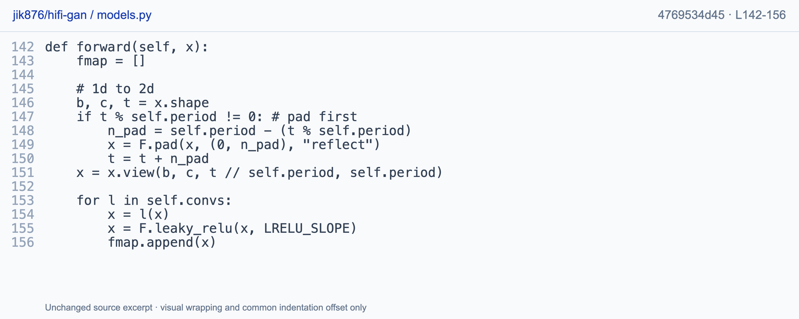
VOCODER
Code: folding samples by period
[B, 1, T] -> padded [B, 1, T/p, p]. For p = 3: [x0,x1,x2], [x3,x4,x5]. Fixed periods, not pitch labels.
Jungil Kong · jik876/hifi-gan · MIT · models.py L142-156 · 4769534d45 · author code
49 / 61
Notes:
The discriminator pads the waveform with reflection when its length is not divisible by the selected period, then reshapes it from batch by channel by time into batch by channel by groups by period. For period three, consecutive rows contain samples zero through two and three through five. Several fixed periods offer complementary views without estimating one exact pitch or requiring pitch labels. The author excerpt is https://github.com/jik876/hifi-gan/blob/4769534d45265d52a904b850da5a622601885777/models.py#L142-L156.

Slide 50
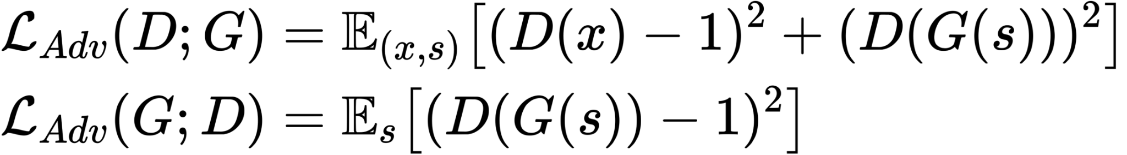
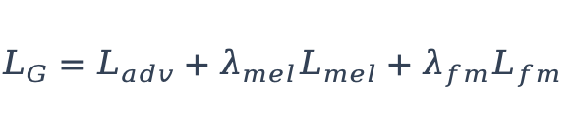
VOCODER
HiFi-GAN : Criterions
$$L_{G}=L_{adv}+λ_{mel}L_{mel}+λ_{fm}L_{fm}$$
1. Least Squares Adversarial Loss (L_{adv})
Generator
Real scores approach 1; generated scores approach 0.
Generated scores approach 1.
2. Mel-Spectrogram Loss (L_{Mel})
Compare target and generated spectral features.
3. Feature Matching Loss (L_{fm})
Compare intermediate discriminator activations.
50 / 61
Notes:
For one discriminator view, the least-squares objective moves real-waveform scores toward one and generated scores toward zero. The generator instead moves generated scores toward one and combines adversarial loss with weighted mel and feature-matching losses. Mel L1 compares generated and target spectral features, whereas feature matching compares intermediate discriminator activations. Here x denotes target audio and s denotes conditioning mel. These consistency signals are complementary and do not formally guarantee intelligibility.

Slide 51
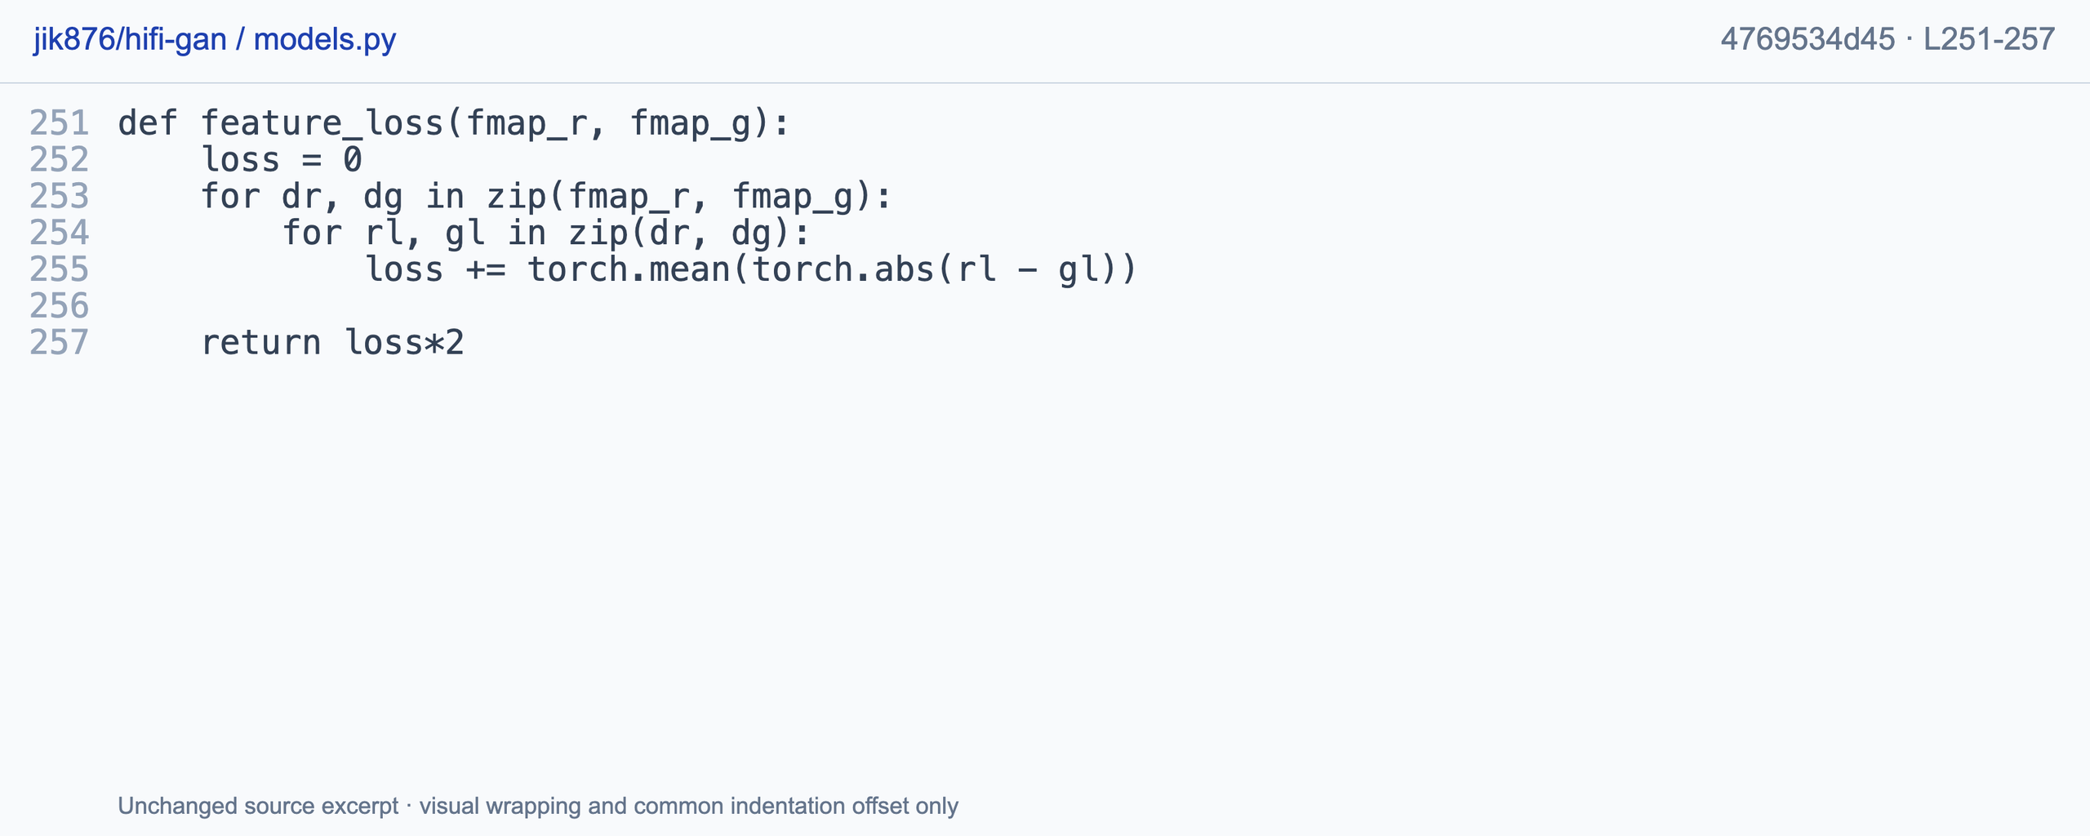
VOCODER
Code : Discriminator Feature Matching Loss
Real / generated layer activations -> summed mean absolute differences. D update control is outside this loss.
Jungil Kong · jik876/hifi-gan · MIT · models.py L251-257 · 4769534d45 · author code
51 / 61
Notes:
Nested lists index discriminator views and their intermediate layers. The loss sums mean absolute differences between real and generated activations and applies this implementation's final multiplier. This compares more information than the final real-or-fake score. Real-feature detachment and discriminator update control belong to the surrounding training loop rather than being established by this function alone. The author source is https://github.com/jik876/hifi-gan/blob/4769534d45265d52a904b850da5a622601885777/models.py#L251-L257.

Slide 52
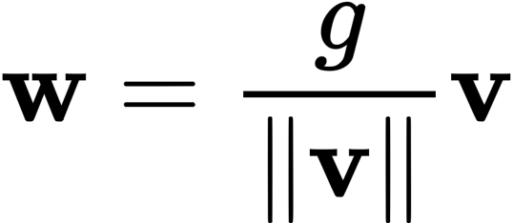
VOCODER
Weight Normalization in Vocoders
Core Reparameterization Formula
Why Not Batch Normalization (BN)?
BN depends on running batch statistics, which fails with dynamic audio lengths and small batch sizes.
WN normalizes layer parameters directly, avoiding activation distortion across audio time steps.
Vector & Scale Decoupling
v : Unconstrained vector determining the filter's direction (scaled to unit length).
g : Scalar parameter controlling weight scale.
Zero-Cost Inference via Weight Folding
Post-training: Fuses g and v into a static weight w.
Removes WN wrapper to eliminate runtime overhead during deployment.
Optimization Benefits
Accelerates gradient convergence and stabilizes deep neural networks without batch dependency.
52 / 61
Notes:
Weight normalization parameterizes a filter as a scale g multiplied by a normalized direction v. Unlike batch normalization, it does not use running input-batch statistics. This adds a reparameterization rather than zero extra parameters. Implementations may fold the resulting weights for inference, with removal behavior depending on the model and normalization API.

Slide 53
VOCODER
Review: vocoder mechanisms
1. Why is mel not uniquely invertible?
2. Are kernels [16, 16, 4, 4] a 4096x expansion?
3. In MPD [T/p, p], which axis indexes phase?
4. Why use more than one STFT window?
Check information loss, stride versus kernel, reshaped axes and analysis resolution.
53 / 61
Notes:
Explain why mel features do not have a unique waveform inverse and why multiplying kernel sizes does not establish expansion. Then identify the phase axis in the period-folded discriminator and explain the purpose of multiple STFT windows. Information loss, stride, tensor axes and analysis resolution provide the mechanisms behind these model names.

Slide 54
VOCODER
Reference answers: vocoders
1. Mel features discard information.
Band aggregation and phase loss prevent a unique waveform inverse.
2. No: use the expansion rates, not kernel sizes.
For HiFi-GAN V1, [8, 8, 2, 2] yields 256x expansion.
3. The p-sized column axis indexes phase positions.
The other axis indexes successive groups of consecutive p samples.
4. Different windows capture complementary detail.
Short windows emphasize time; long windows resolve frequency.
Correct units and axes matter as much as architecture names.
54 / 61
Notes:
Mel aggregation and phase loss discard information. HiFi-GAN V1 expands by the product of its rates, yielding two hundred and fifty-six rather than the product of kernel sizes. In the period-folded layout, the period-sized column axis indexes phase while the other indexes successive groups. Short and long STFT windows emphasize time and frequency detail respectively. Units and axes are therefore central to implementation reasoning.

Slide 55
EVALUATION
How to Measure Quality?
Dimension | Primary Listener Question | Typical failure
Intelligibility | Can I understand the words? | Skipped or blurred phonemes
Naturalness | Does it sound like a person? | Robotic prosody or buzz
Similarity | Does it sound like the target speaker? | Wrong timbre / identity
Pleasantness | Is it comfortable to listen to? | Harshness, hiss, fatigue
Prosody | Are intonation and pauses appropriate? | Flat or misplaced emphasis
55 / 61
Notes:
[Sources]
- User-provided outline: week9 TTS 大纲.docx
- User-provided reference deck and diagrams: week 9 _ Classical TTS.pptx

Slide 56
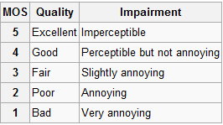
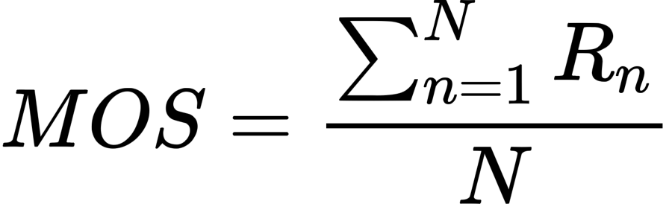
EVALUATION
Mean Opinion Score (MOS)
Mathematical Formula
Key Strengths
Intuitive and widely understood across academic Intuitive and widely understood across academic
Standard Protocol Requirements
Limitations & Pain Points
Requires controlled environments & listener panels.
Must report sample size (N) and uncertainty.
Expensive & Time-Consuming: High human labor cost.
High Variance & Ceiling Effect: Hard to resolvesubtle model improvements near human quality.
56 / 61
Notes:
[Sources]
- User-provided outline: week9 TTS 大纲.docx
- User-provided reference deck and diagrams: week 9 _ Classical TTS.pptx

Slide 57
EVALUATION
MUSHRA & Side-by-side (AB) Tests
MUSHRA
Side-by-side / AB
Evaluates multiple stimuli simultaneously against:
- Explicit Reference
- Hidden Reference & Low-Quality Anchor
Uses a continuous 0–100 score scale.
Best Used For
Differentiating between multiple high-quality systems where MOS encounters ceiling effects.
Directly compares two audio samples (A vs B).
Task: Listener selects the preferred option.
Key Advantages
Binary Choice: Eliminates individual differences in rating-scale habits across listeners.
High Sensitivity: Extremely sensitive to hard, audible errors and artifacts.
Decision Rule Guidelines:
Use MUSHRA when you need to rank and benchmark a set of multiple systems.
Use AB Testing when asking a focused A/B preference question for a single model change.
57 / 61
Notes:
[Sources]
- User-provided outline: week9 TTS 大纲.docx
- User-provided reference deck and diagrams: week 9 _ Classical TTS.pptx

Slide 58
EVALUATION
Summary & Metric Family Matrix
Ask one condition
Metric family | Output | Best use
MOS | 1–5 average | Overall quality
MUSHRA | 0–100 per sample | Fine-grained ranking
AB / SBS | A or B | Preference for a change
Binary | Yes / No | Failure diagnosis
Noise Check:
“Does the sample contain audible background noise?”
Intelligibility Check:
“Can the listener identify the sentence?”
Speaker Identity Check:
“Does the voice sound like the target speaker?”
Purpose
Converts vague listener feedback into actionable engineering diagnostics (e.g., failure tagging)
The evaluation protocol should be designed around the failure you want to detect.
58 / 61
Notes:
[Sources]
- User-provided outline: week9 TTS 大纲.docx
- User-provided reference deck and diagrams: week 9 _ Classical TTS.pptx

Slide 59
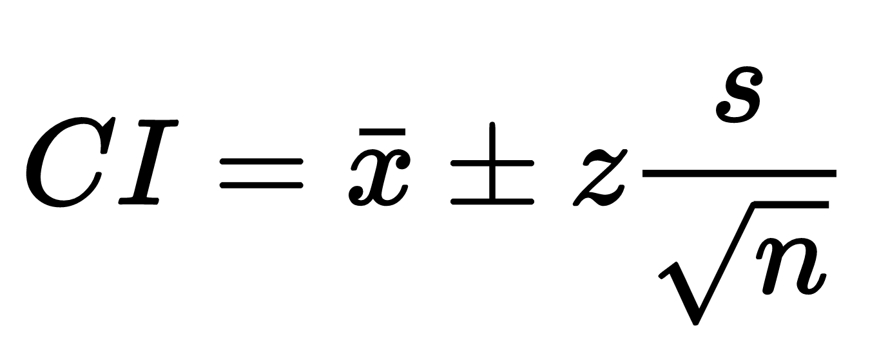
EVALUATION
Crowdsourcing & Statistical Rigor
Crowdsourcing Implementation & Quality Control
Confidence interval
Crowdsourcing Advantages
Scalability: Access to a large, diverse listener pool across demographics and locations.
Cost Efficiency: Significantly cheaper than setting up dedicated acoustic laboratories.
Mathematical Formula
Reporting Requirements & Best Practices
Complete Transparency: Always report mean score, sample size (n), and CI together
Essential Quality Controls
Pre-test Screening (hearing checks).
Device Checks (enforcing headphone usage).
Attention Trap Checks (filtering random clickers).
Critical Statistical Insight
A 0.05 MOS difference is not automatically meaningful unless supported by CI bounds.
59 / 61
Notes:
[Sources]
- User-provided outline: week9 TTS 大纲.docx
- User-provided reference deck and diagrams: week 9 _ Classical TTS.pptx

Slide 60
DATA & ENGINEERING
Public Datasets in TTS
Dataset | Typical use | Coverage | Main caveat
LJSpeech | Single-speaker baseline | Clean English, ~24 h | One speaker / narrow style
LibriTTS | Multi-speaker and robustness | Many speakers, audiobook speech | Variable recording conditions
Common Voice | Multilingual / accents | Crowdsourced languages | Uneven quality and labels
OpenTTS / analogs | Supplementary resources | Task- or language-specific | License and comparability
Core Takeaway: A model trained on one clean single-speaker dataset should never be described as universally robust without explicit zero-shot or out-of-domain evaluation.
60 / 61
Notes:
[Sources]
- User-provided outline: week9 TTS 大纲.docx
- User-provided reference deck and diagrams: week 9 _ Classical TTS.pptx

Slide 61
REFERENCES
Selected references
• Tacotron 2 — arXiv:1712.05884
• Guided Attention — arXiv:1906.00672
• Global Style Tokens — arXiv:1803.09017
• FastSpeech / FastSpeech 2 — arXiv:1905.09263, arXiv:2006.04558
• WaveNet — arXiv:1609.03499
• Parallel WaveGAN — arXiv:1910.11480
• MelGAN — arXiv:1910.06711
• HiFi-GAN — arXiv:2010.05646
• Weight Normalization — arXiv:1602.07868
• Montreal Forced Aligner — Interspeech 2017
All architecture figures in this deck are adapted from the user-provided reference PPTX; the visual system follows the previously supplied source-separation courseware.
61 / 61
Notes:
[Sources]
- User-provided outline: week9 TTS 大纲.docx
- User-provided reference deck and diagrams: week 9 _ Classical TTS.pptx
- Tacotron 2, arXiv:1712.05884
- Guided Attention, arXiv:1906.00672
- Global Style Tokens, arXiv:1803.09017
- FastSpeech, arXiv:1905.09263
- FastSpeech 2, arXiv:2006.04558
- WaveNet, arXiv:1609.03499
- Parallel WaveGAN, arXiv:1910.11480
- MelGAN, arXiv:1910.06711
- HiFi-GAN, arXiv:2010.05646
- Weight Normalization, arXiv:1602.07868
- Montreal Forced Aligner, Interspeech 2017

